Slide 1
Benchmarking Top IaaS providers using Real Time User Metrics
Using Cassandra storage and ycsb tool

Slide 2
Schema
IaaS providers under Study
Setting up the system in Google Compute Engine
Setting up the system in Microsoft Azure
Setting up the system in CenturyLink
Setting up the system in Amazon Web Services
Deploying Cassandra in the nodes under the CSPs
Deploying YCSB in a test node for benchmarking
Benchmark Discussion

Slide 3




IaaS Cloud Providers – Under Study

Slide 4
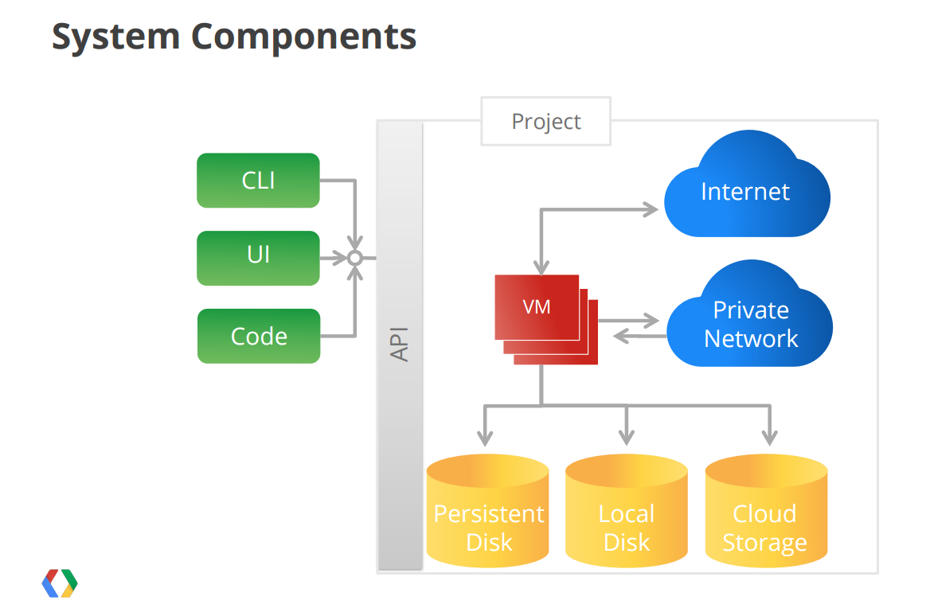
Google’s Compute Engine (GCE) - Architecture
Notes:
Source : http://commondatastorage.googleapis.com/io2012/presentations/live%20to%20website/313.pdf

Slide 5
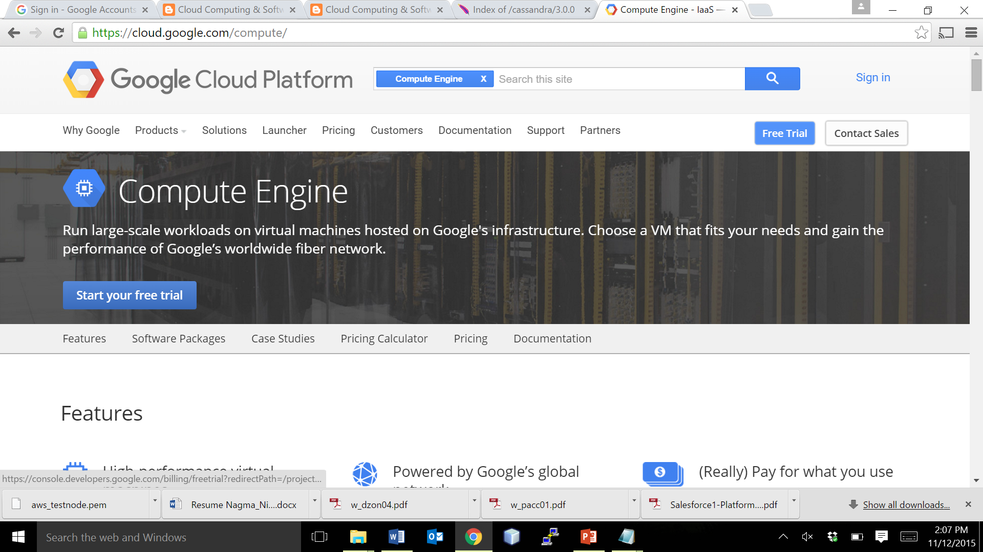
Creating a User ID for using GCE
Navigate to the URL https://cloud.google.com/compute/ → Create an ID, or use your existing gmail ID to sign up. Initially every user gets $300 free credit that can be used upto 30 days from the date of sign up.
1. Click on Free Trial

Slide 6
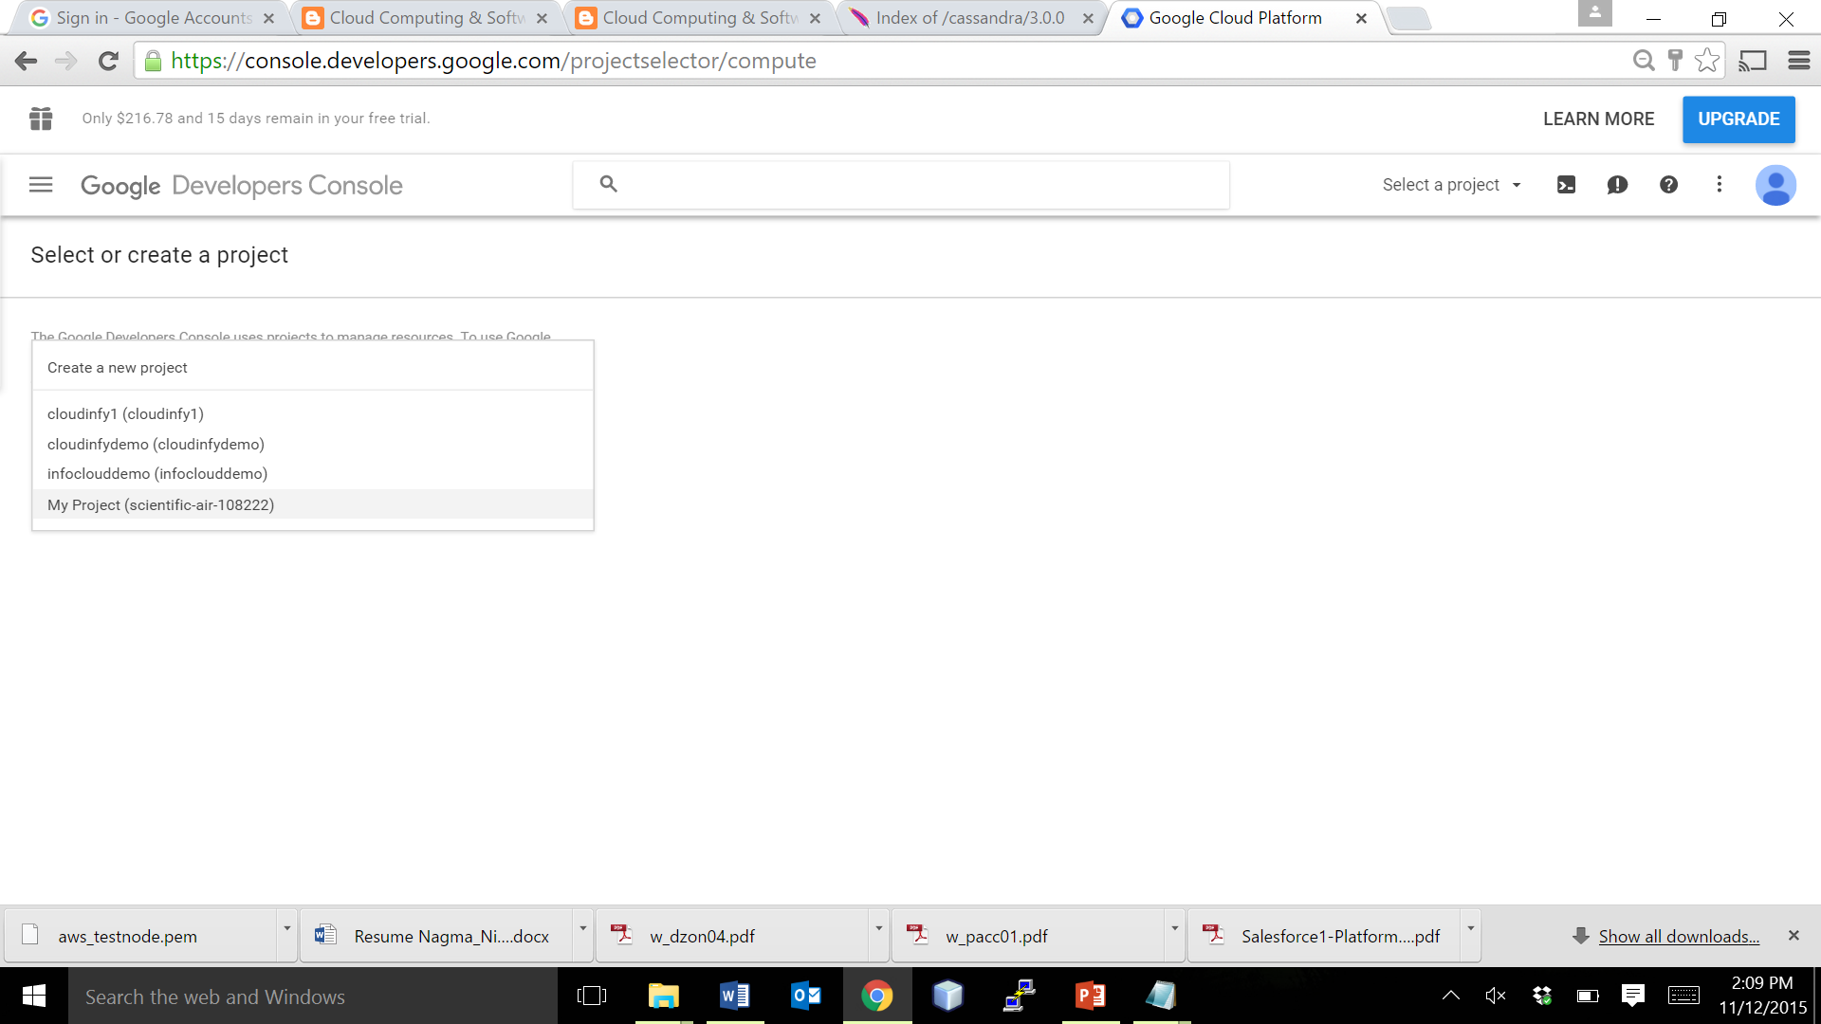
Logging in to Console
Create/Select the project that you want to use, from the window as shown below.
Create or select a project

Slide 7
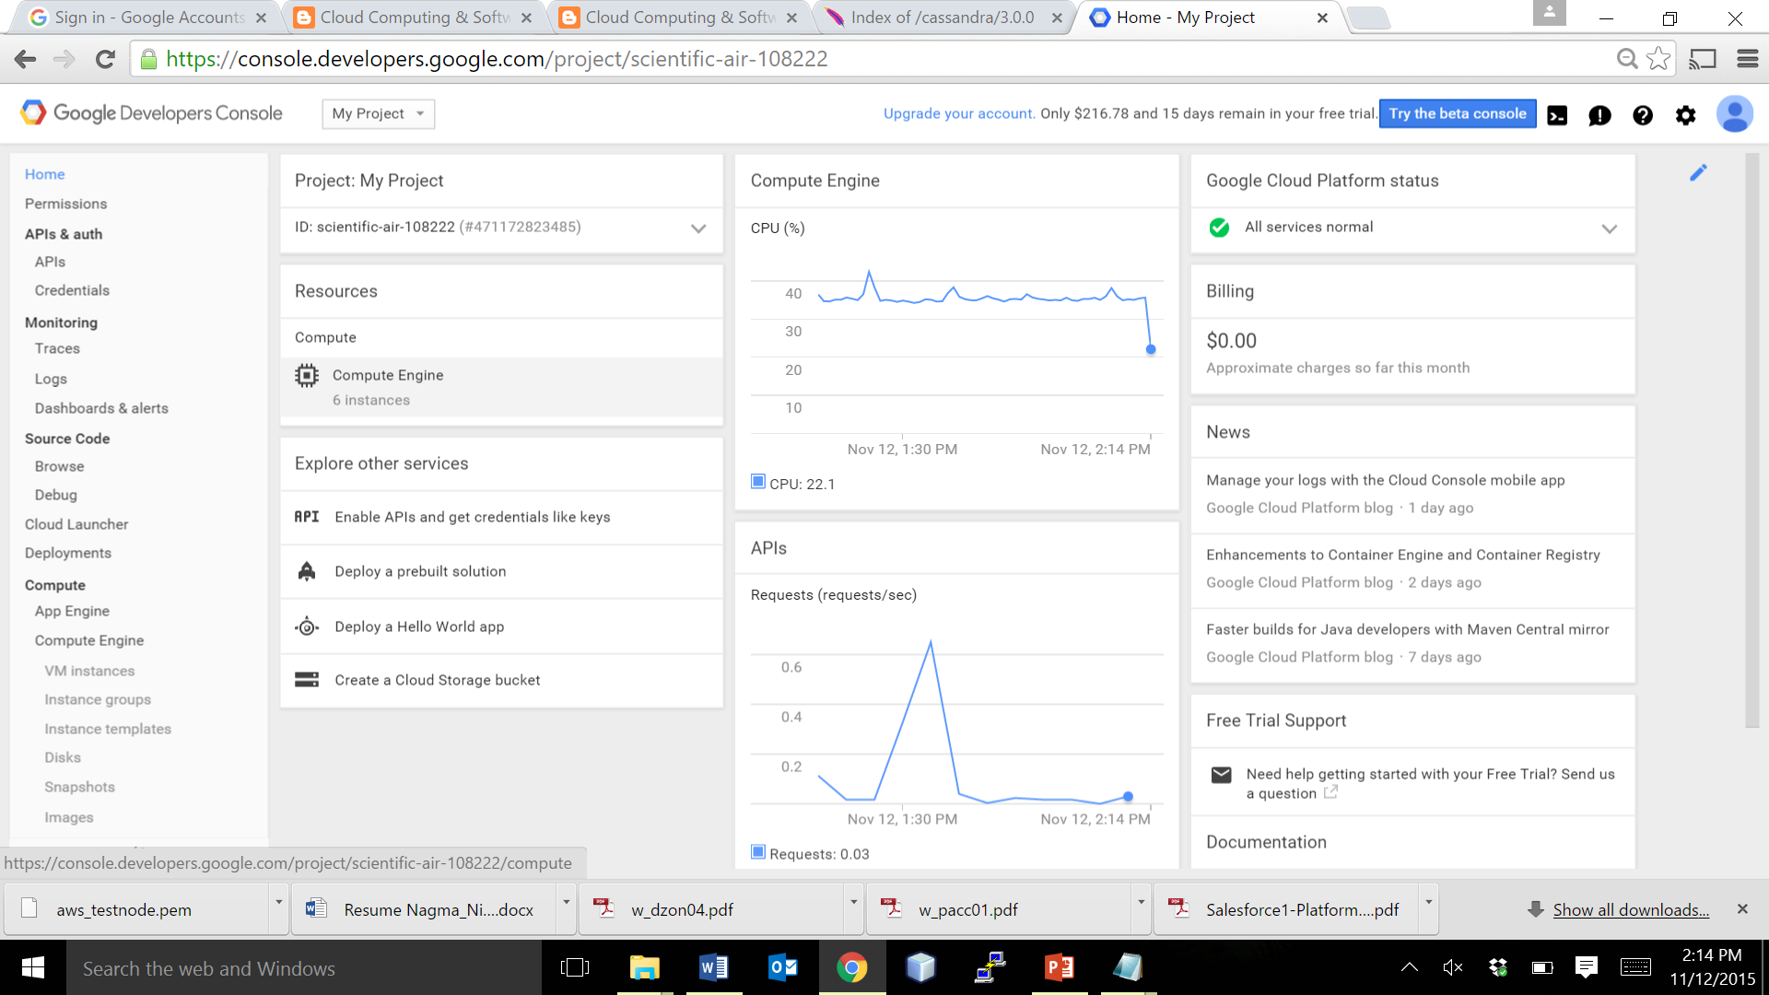
Google Developers Console
The Google Developers Console is the main dashboard of all the activities that you can control.
The Links here helps in navigation.

Slide 8
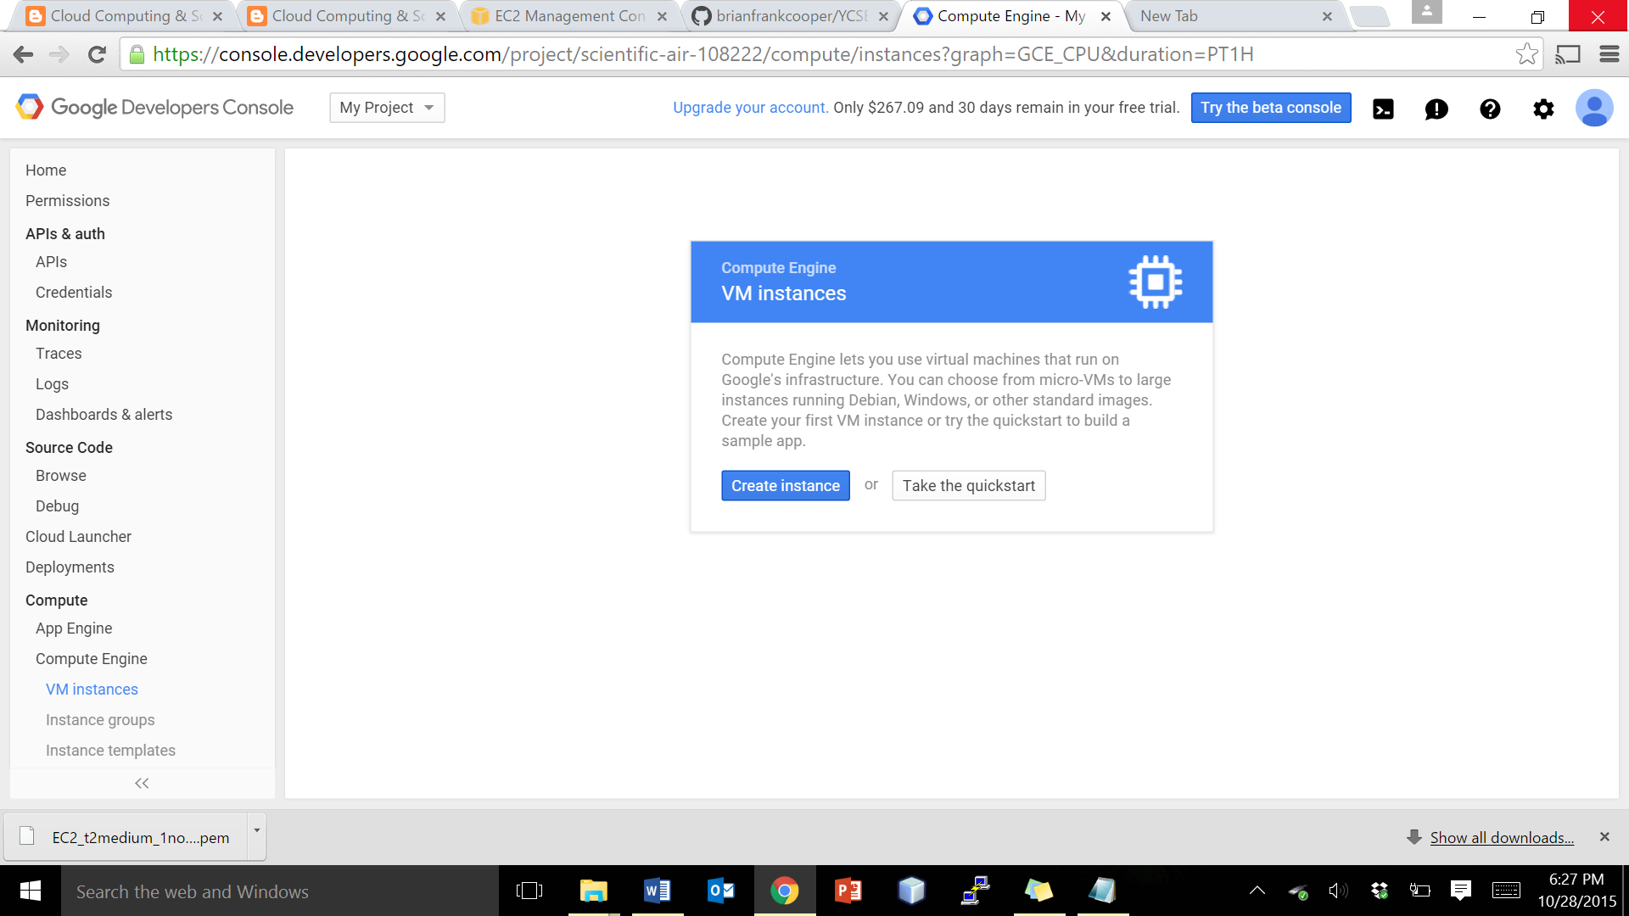
Creating an Instance – Step 1/4
Google Compute Engine helps you to launch instances within a minute. So Simple ☺
2. Click on Create instance button to create your instance
1. Click on Compute Engine Link

Slide 9
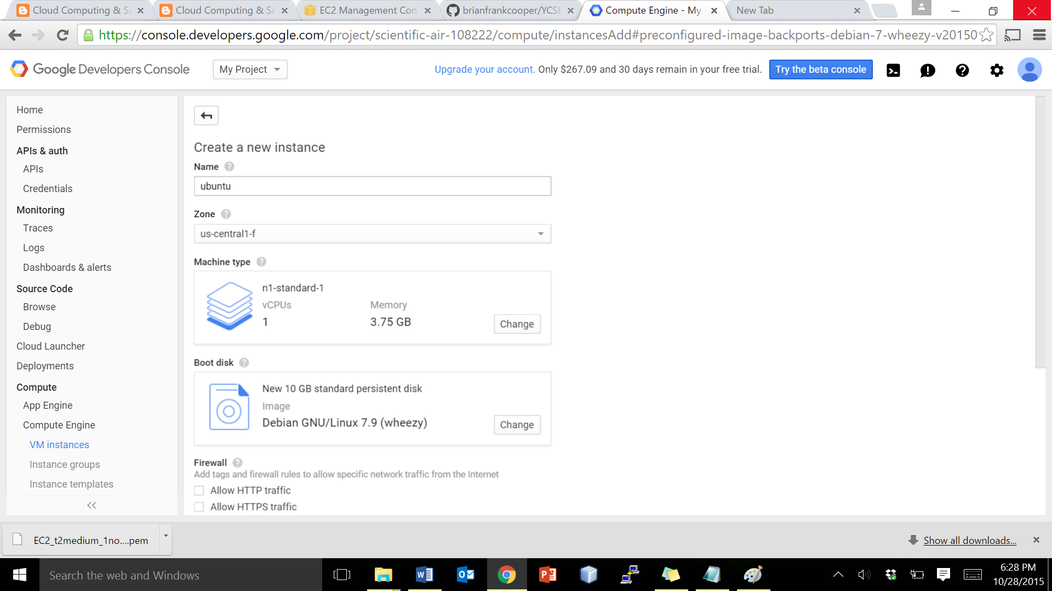
Creating an Instance – Step 2/4
1. Give a name for your instance in lowercase letters.
2. Select a zone. Note that this is important, in free tier you can opt a maximum of 8 vCPUs per zone.

Slide 10
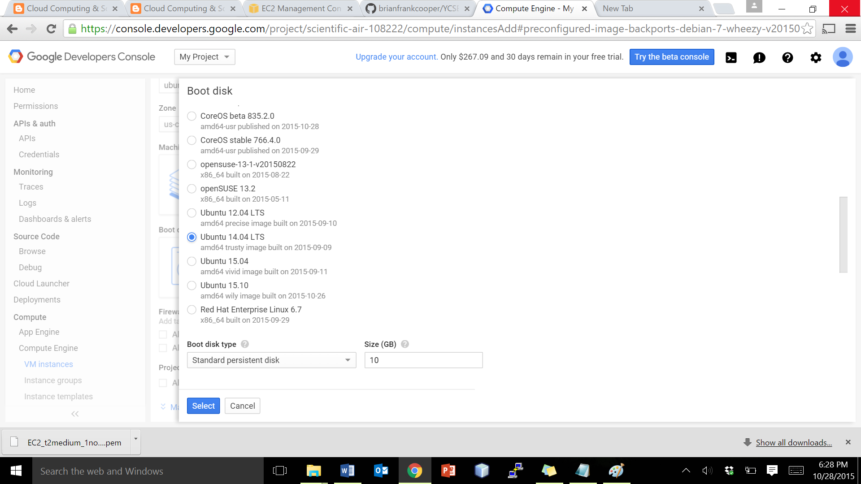
Creating an Instance – Step 3/4
Select the OS disk that you want your instance to boot up.
Select the Book disk type, and size of the disk your VM should be

Slide 11
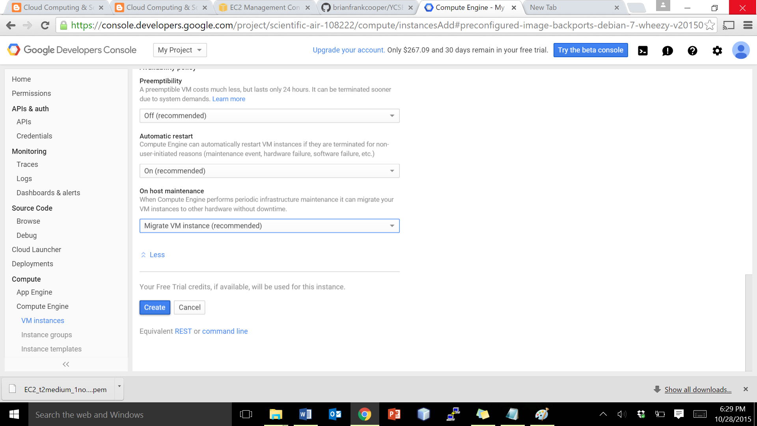
Creating an Instance – Step 4/4
Review the details of your VM and click on Create button.

Slide 12
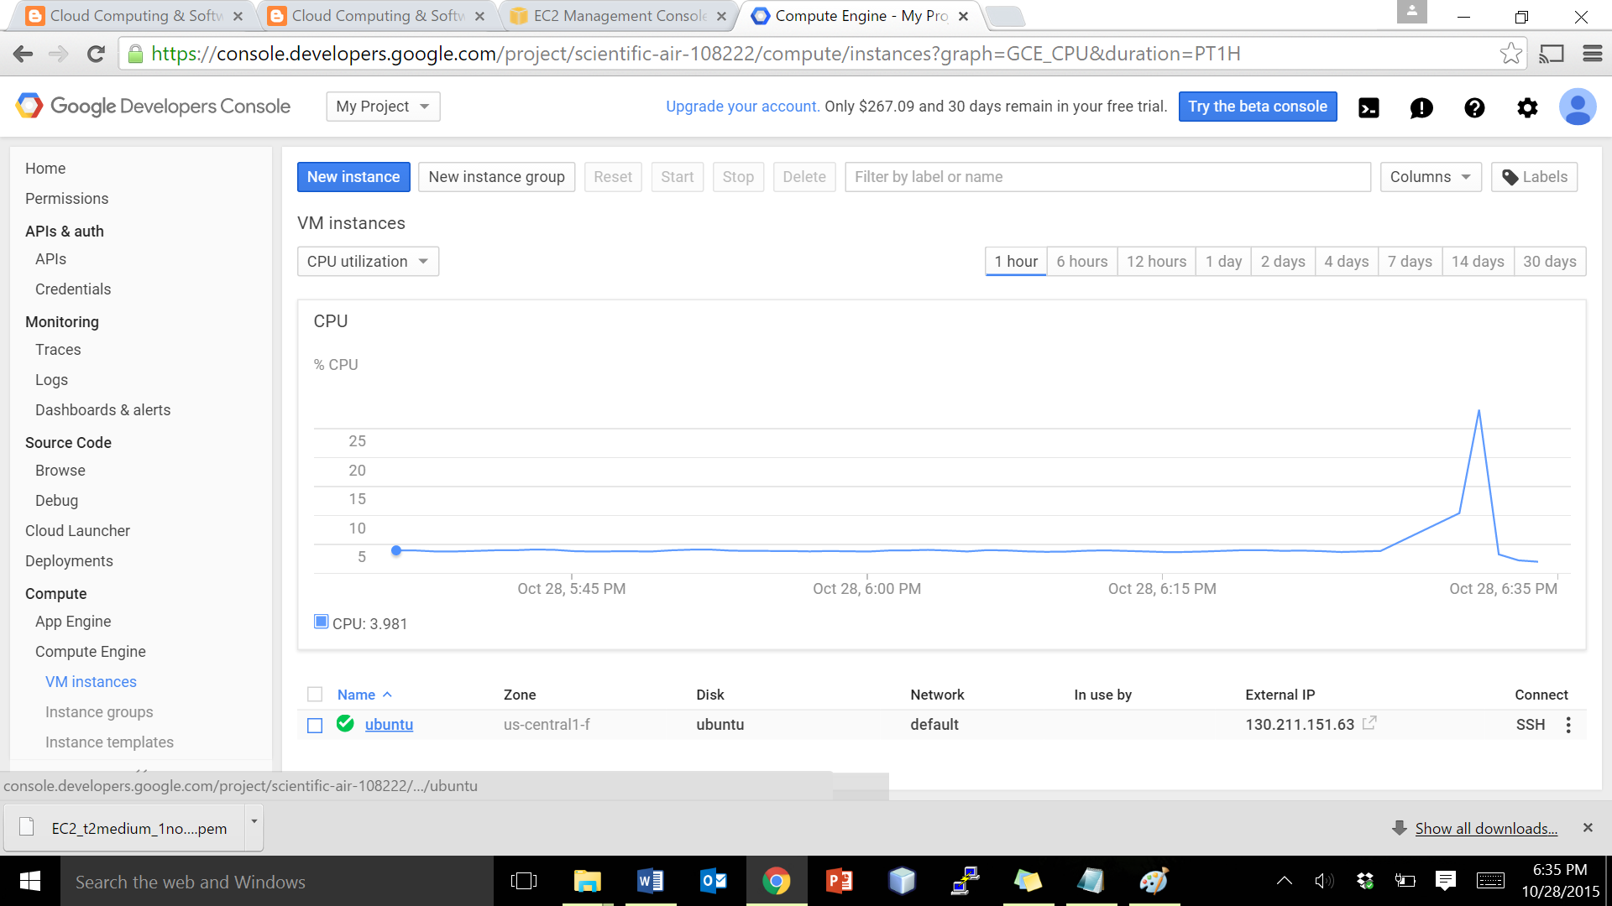
Creating an Instance – Instance Details
Instance is created, and it appears in the VM Instances link of the Console
Click on the instance name, to view its details.

Slide 13
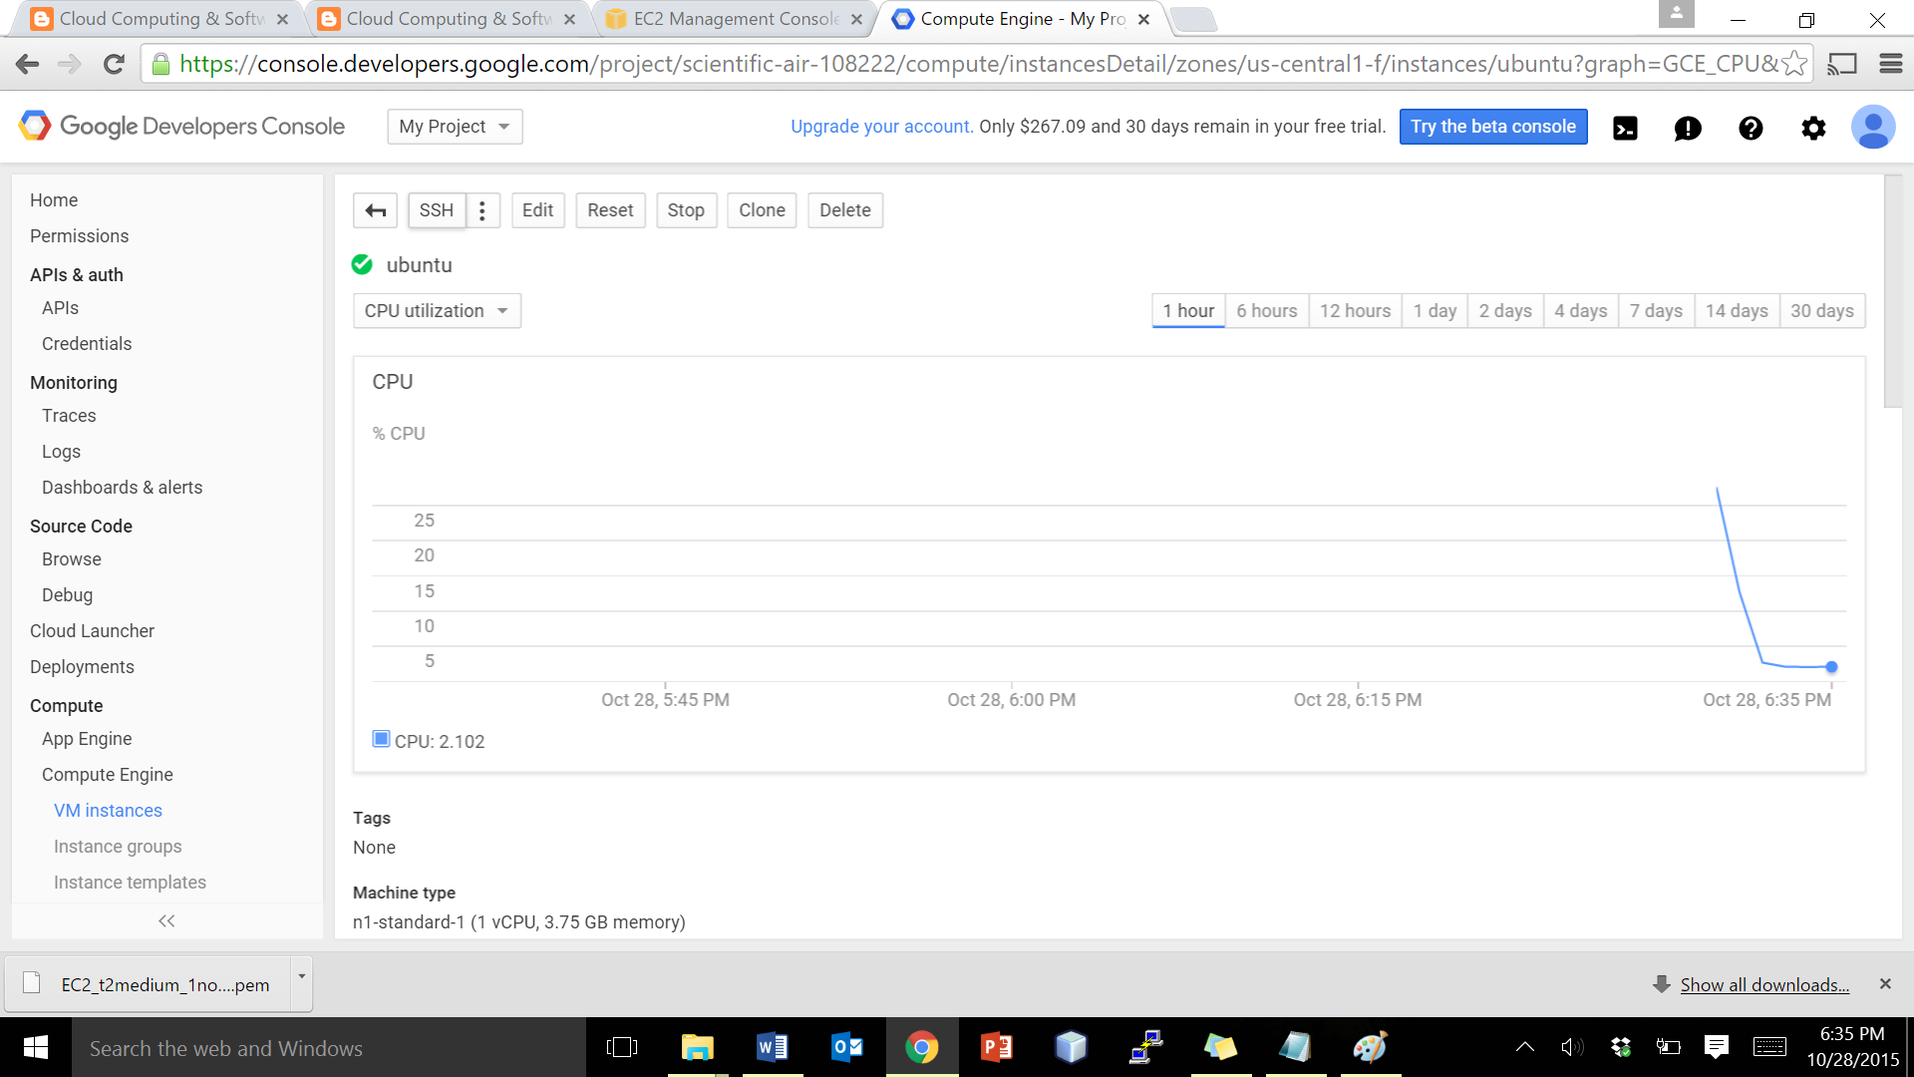
Instance is UP and Running
VM can be controlled using these options
This graph shows the CPU utilization percentage

Slide 14
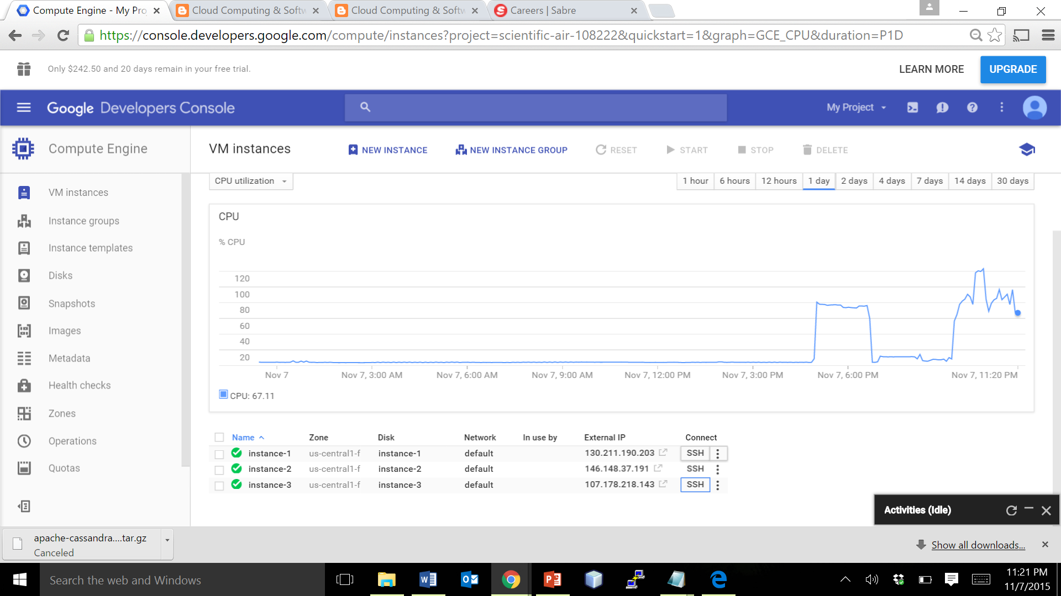
Connecting the instances
Easiest way to connect is to use this SSH button. We can also connect using puTTY.
Follow the same steps to create ‘n’ number of VMs. All the VMs can be managed under a project inside the Console

Slide 15
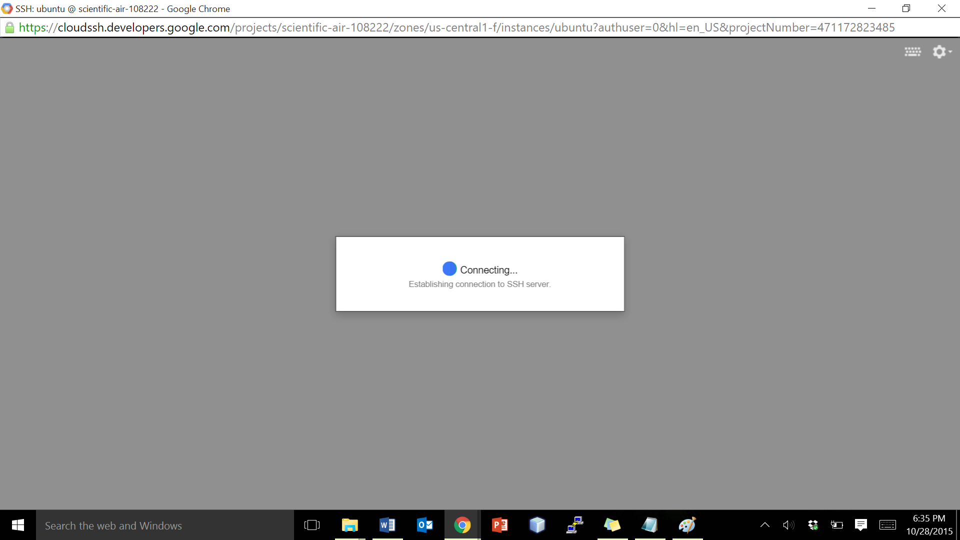
Establishing connection to the SSH server

Slide 16
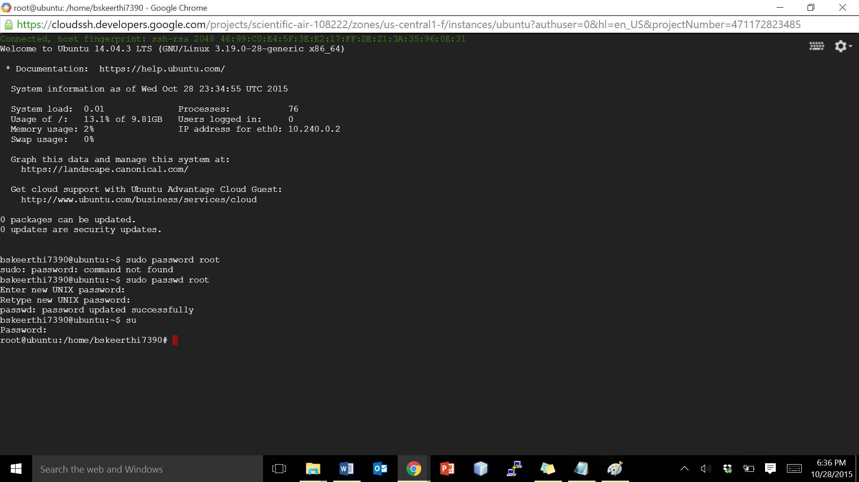
Accessing the instance
The terminal opens as a web interface page with Google customized options

Slide 17
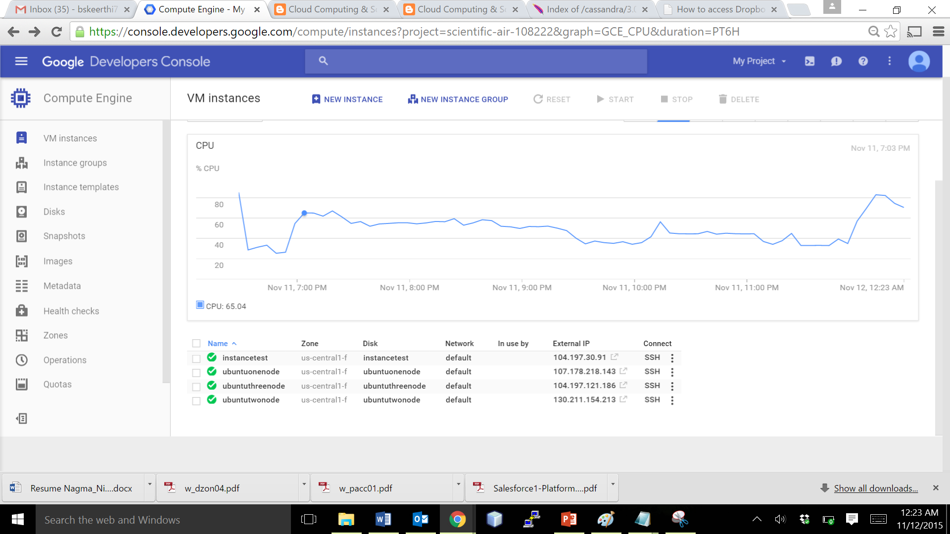
Benchmarking : 3 Nodes + 1 Test Node
Create 3 VMs for Cassandra Cluster Setup, and 1 for Test Node

Slide 18
Installing Cassandra in 3 Nodes
Follow these steps in all the 3 NODES :
Step 1: Change root password sudo passwd root <enter password> su <password> Step 2: Install Oracle Java 8 in Ubuntu via PPA sudo add-apt-repository ppa:webupd8team/java sudo apt-get update sudo apt-get install oracle-java8-installer Step 3: Set Java environment variables sudo apt-get install oracle-java8-set-default sudo apt-get update

Slide 19
Installing Cassandra in 3 Nodes
Step 4. Install Cassandra
mkdir /usr/local/Cassandra
cd /usr/local/Cassandra
wget http://apache.cs.utah.edu/cassandra/2.2.3/apache-cassandra-2.2.3-bin.tar.gz
tar xvfz apache-cassandra-2.2.3-bin.tar.gz
Step 5. Check IP address of instances
Ifconfig
//example : <IPAddress>

Slide 20
Installing Cassandra in 3 Nodes
Step 6. Make a backup for all nodes
cp apache-cassandra-2.2.2/conf/cassandra.yaml apache-cassandra-2.2.2/conf/cassandra.yaml_bak
Step 7. Modify configuration for all nodes.
vim apache-cassandra-2.2.2/conf/cassandra.yaml
Note:
Find listen_address: and seeds: (Ctrl+W) and modify it
listen_address should be own IP of each instance.
listen_address: <IPAddress>
seeds: "<IPAddress>,172.31.42.247,172.31.42.151"
rpc_address: 0.0.0.0
broadcast_rpc_address: 1.2.3.4

Slide 21
Installing Cassandra in 3 Nodes
Step 8. Excute cassandra
/usr/local/cassandra/apache-cassandra-2.2.3/bin/cassandra
/usr/local/cassandra/apache-cassandra-2.2.3/bin/nodetool -h localhost -p 7199 status
Note: All 3 nodes should be ready
/usr/local/cassandra/apache-cassandra-2.2.3/bin/cqlsh
Step 9. Create keyspace and table for YCSB benchmark
CREATE KEYSPACE usertable WITH REPLICATION = { 'class' : 'SimpleStrategy', 'replication_factor' : 3};
use usertable;
CREATE TABLE usertable.data ( key blob, column1 text, value blob, PRIMARY KEY (key, column1)) WITH COMPACT STORAGE AND CLUSTERING ORDER BY (column1 ASC);
describe table data;

Slide 22
Installing YCSB in Test Node
Follow these steps in the Test Node only.
Step 1: Change root password sudo passwd root <enter password> su <password> Step 2: Install Oracle Java 8 in Ubuntu via PPA sudo add-apt-repository ppa:webupd8team/java sudo apt-get update sudo apt-get install oracle-java8-installer Step 3: Set Java environment variables sudo apt-get install oracle-java8-set-default sudo apt-get update

Slide 23
Installing YCSB in Test Node
Step 4: Install YCSB
curl -O --location https://github.com/brianfrankcooper/YCSB/releases/download/0.4.0/ycsb-0.4.0.tar.gz tar xfvz ycsb-0.4.0.tar.gz cd ycsb-0.4.0
Step 5: Create workload files in workload folder (Other workload code is in the comment section) vim workload_test10 recordcount=214748 operationcount=100000 workload=com.yahoo.ycsb.workloads.CoreWorkload readallfields=true readproportion=0.5435 updateproportion=0.4565 scanproportion=0 insertproportion=0 requestdistribution=zipfian
Notes:
vim workload_test40 ------------------------------------------------------------- recordcount=536871 operationcount=400000 workload=com.yahoo.ycsb.workloads.CoreWorkload readallfields=true readproportion=0.5435 updateproportion=0.4565 scanproportion=0 insertproportion=0 requestdistribution=zipfian ------------------------------------------------------------
vim workload_test320 ------------------------------------------------------------- recordcount=3543348 operationcount=3200000 workload=com.yahoo.ycsb.workloads.CoreWorkload readallfields=true readproportion=0.5435 updateproportion=0.4565 scanproportion=0 insertproportion=0 requestdistribution=zipfian ------------------------------------------------------------
vim workload_test640
------------------------------------------------------------- recordcount=6120328 operationcount=6400000 workload=com.yahoo.ycsb.workloads.CoreWorkload readallfields=true readproportion=0.5435 updateproportion=0.4565 scanproportion=0 insertproportion=0 requestdistribution=zipfian ------------------------------------------------------------ vim workload_test1200 ------------------------------------------------------------ recordcount=10630044 operationcount=12000000 workload=com.yahoo.ycsb.workloads.CoreWorkload readallfields=true readproportion=0.5435 updateproportion=0.4565 scanproportion=0 insertproportion=0 requestdistribution=zipfian ------------------------------------------------------------

Slide 24
Installing YCSB in Test Node
8. Create a folder for results
mkdir results_Cassandra
9. Load data
./bin/ycsb load cassandra-10 -P workloads/workload_test10 -p hosts=<IPAddress> -threads 10 -p columnfamily=data -s > results_Cassandra/load_10
10. Run benchmark
./bin/ycsb run cassandra-10 -P workloads/workload_test10 -p hosts=<IPAddress> -threads 10 -p columnfamily=data -s > results_Cassandra/run_10
11. Clean loaded data for next benchmark (REFER TO THE NOTES SECTION FOR OTHER BENCHMARKS)
drop table data; CREATE TABLE usertable.data ( key blob, column1 text, value blob, PRIMARY KEY (key, column1)) WITH COMPACT STORAGE AND CLUSTERING ORDER BY (column1 ASC);
Notes:
11. Repeat benchmark with different configurations.
//Note: benchmark for 40 concurrent users
./bin/ycsb load cassandra-10 -P workloads/workload_test40 -p hosts=<IPAddress> -threads 40 -p columnfamily=data -s > results_Cassandra/load_40
./bin/ycsb run cassandra-10 -P workloads/workload_test40 -p hosts=<IPAddress> -threads 40 -p columnfamily=data -s > results_Cassandra/run_40
drop table data; CREATE TABLE usertable.data ( key blob, column1 text, value blob, PRIMARY KEY (key, column1)) WITH COMPACT STORAGE AND CLUSTERING ORDER BY (column1 ASC);
//Note: benchmark for 320 concurrent users
./bin/ycsb load cassandra-10 -P workloads/workload_test320 -p hosts=<IPAddress> -threads 320 -p columnfamily=data -s > results_Cassandra/load_320
./bin/ycsb run cassandra-10 -P workloads/workload_test320 -p hosts=<IPAddress> -threads 320 -p columnfamily=data -s > results_Cassandra/run_320
drop table data; CREATE TABLE usertable.data ( key blob, column1 text, value blob, PRIMARY KEY (key, column1)) WITH COMPACT STORAGE AND CLUSTERING ORDER BY (column1 ASC);
//Note: benchmark for 640 concurrent users
./bin/ycsb load cassandra-10 -P workloads/workload_test640 -p hosts=<IPAddress> -threads 640 -p columnfamily=data -s > results_Cassandra/load_640
./bin/ycsb run cassandra-10 -P workloads/workload_test640 -p hosts=<IPAddress> -threads 640 -p columnfamily=data -s > results_Cassandra/run_640
drop table data; CREATE TABLE usertable.data ( key blob, column1 text, value blob, PRIMARY KEY (key, column1)) WITH COMPACT STORAGE AND CLUSTERING ORDER BY (column1 ASC);
//Note: benchmark for 1200 concurrent users
./bin/ycsb load cassandra-10 -P workloads/workload_test1200 -p hosts=<IPAddress> -threads 1200 -p columnfamily=data -s > results_Cassandra/load_1200
./bin/ycsb run cassandra-10 -P workloads/workload_test1200 -p hosts=<IPAddress> -threads 1200 -p columnfamily=data -s > results_Cassandra/run_1200
drop table data;
CREATE TABLE usertable.data ( key blob, column1 text, value blob, PRIMARY KEY (key, column1)) WITH COMPACT STORAGE AND CLUSTERING ORDER BY (column1 ASC);

Slide 25
Some Issues you might want to know!
Issue 1: A table in Cassandra was unable to be dropped or truncated.
Possible Reason & Solution : When you want to drop or truncate a table data in a Cassandra Userspace, then all the nodes in the Cassandra Cluster must be up. This can be checked by using the nodetool command. Make sure you run Cassandra in all the nodes and then use the drop or truncate command.
Issue 2: 7199 port already in use
Possible Reason & Solution : You can manually kill the Cassandra process in all the nodes using the below command and run it again.
user=`whoami`
pgrep -u $user -f cassandra | xargs kill -9

Slide 26
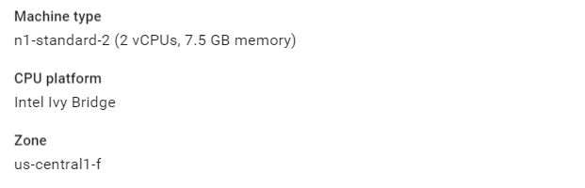
Configuration of a GCE instance

Slide 27
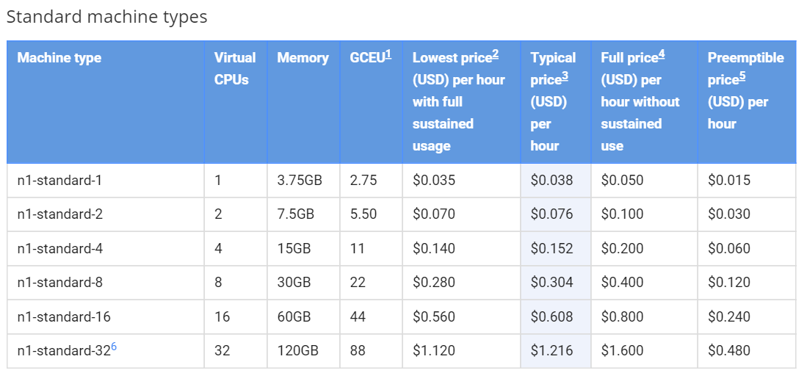
Pricing of a GCE instance

Slide 28
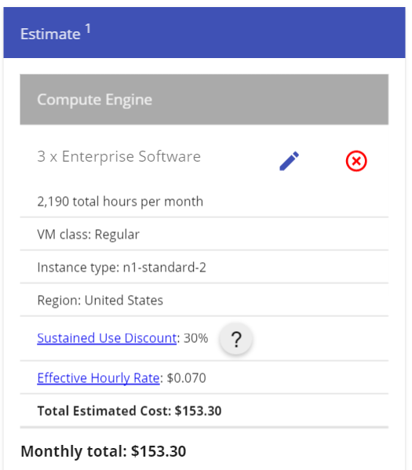
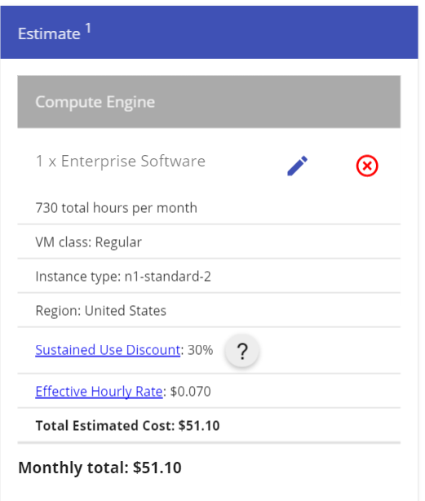
Monthly Estimate

Slide 29
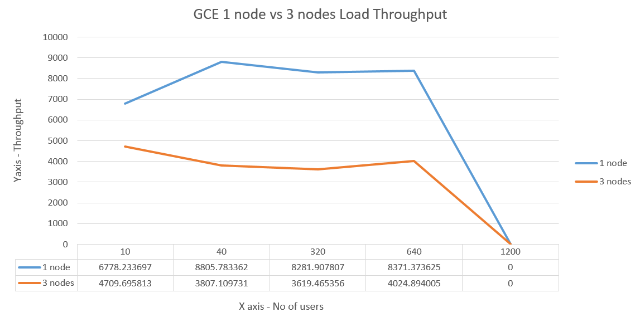
Graph Analysis of GCE Load Throughput

Slide 30
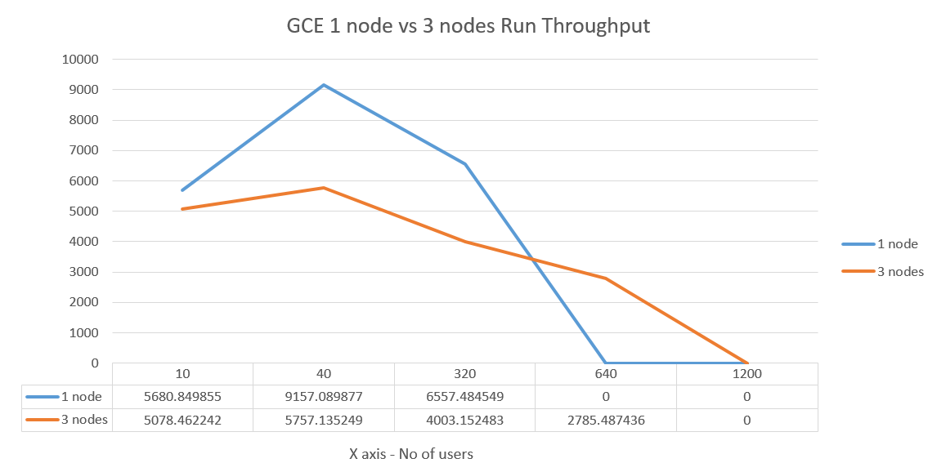
Graph Analysis of GCE Run Throughput

Slide 31
Public Cloud Services – Under Study

Slide 32
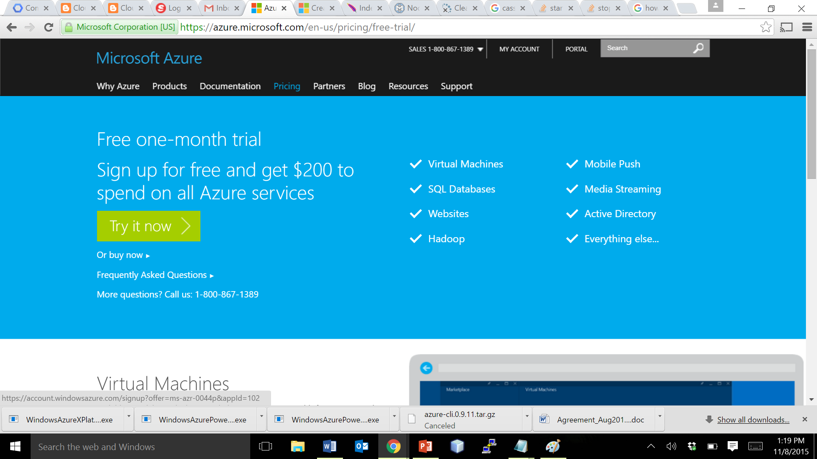
Creating an Account – Login to Azure
Navigate to the URL https://azure.microsoft.com/en-us/pricing/free-trial/ → Create an Azure ID, and get in to the free trial page as shown below.
Click on Try it now button to start with.

Slide 33
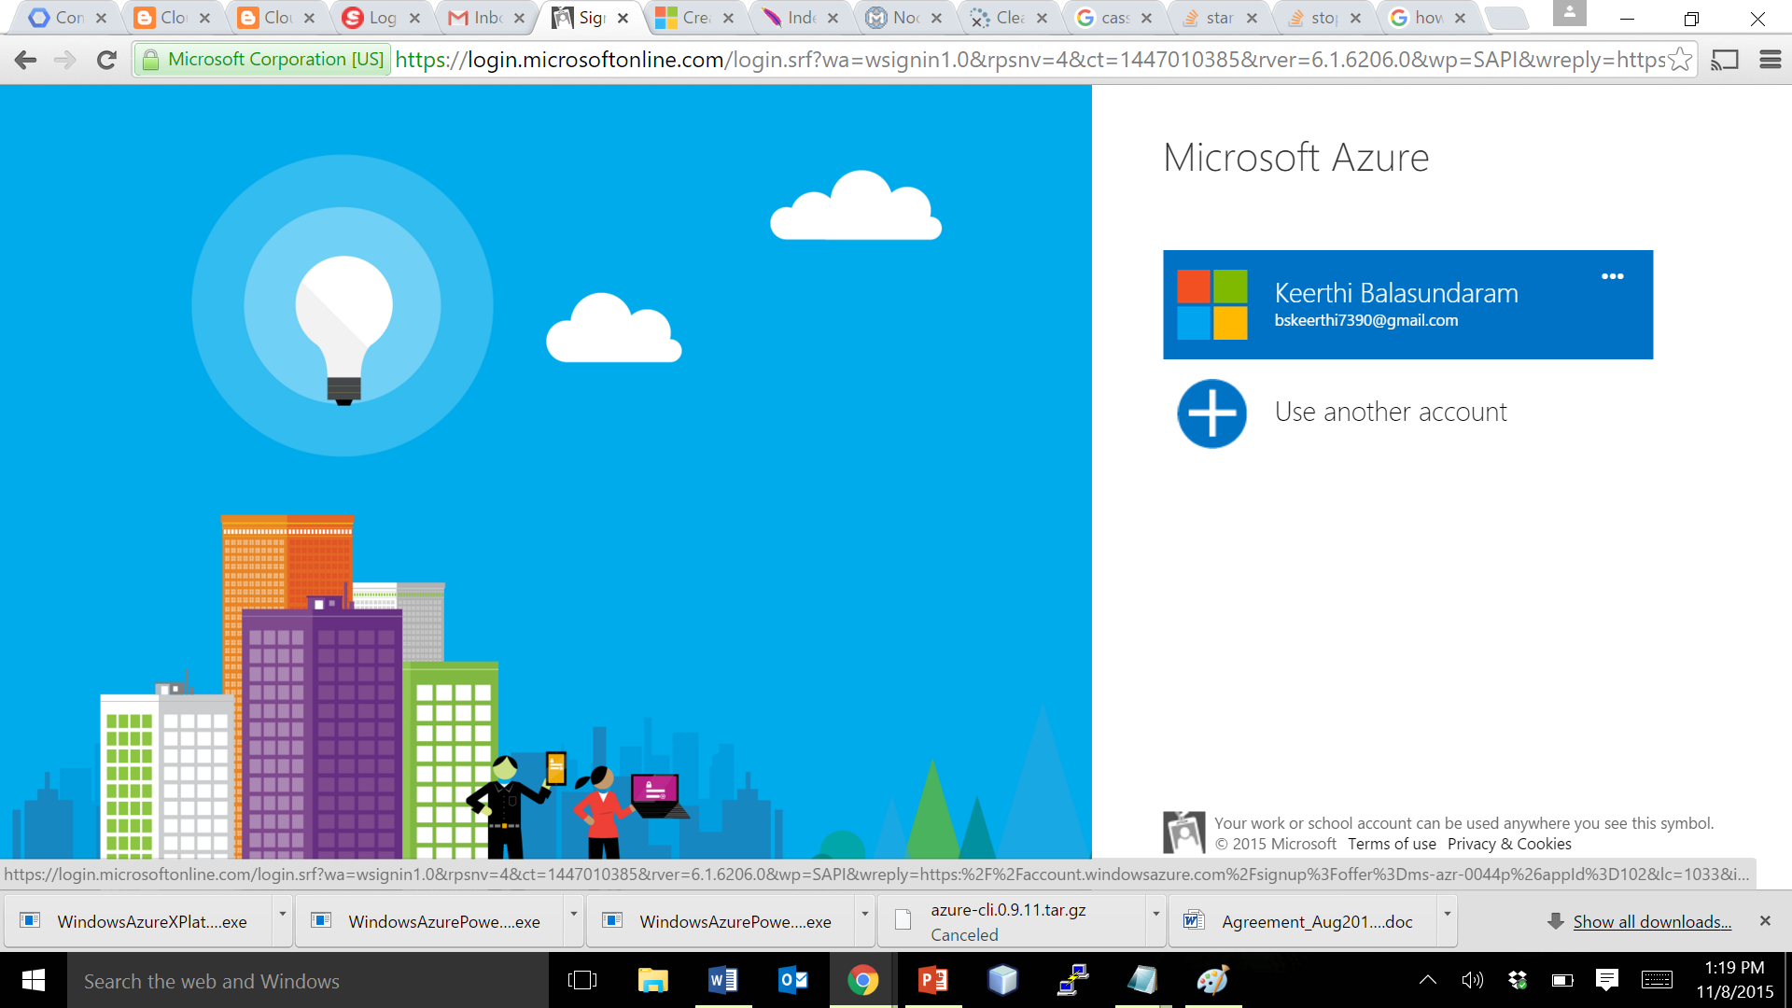
Creating an Account – Creating your ID
Use an existing login, or create a new one
Azrure offers a month of free usage to use it’s services

Slide 34
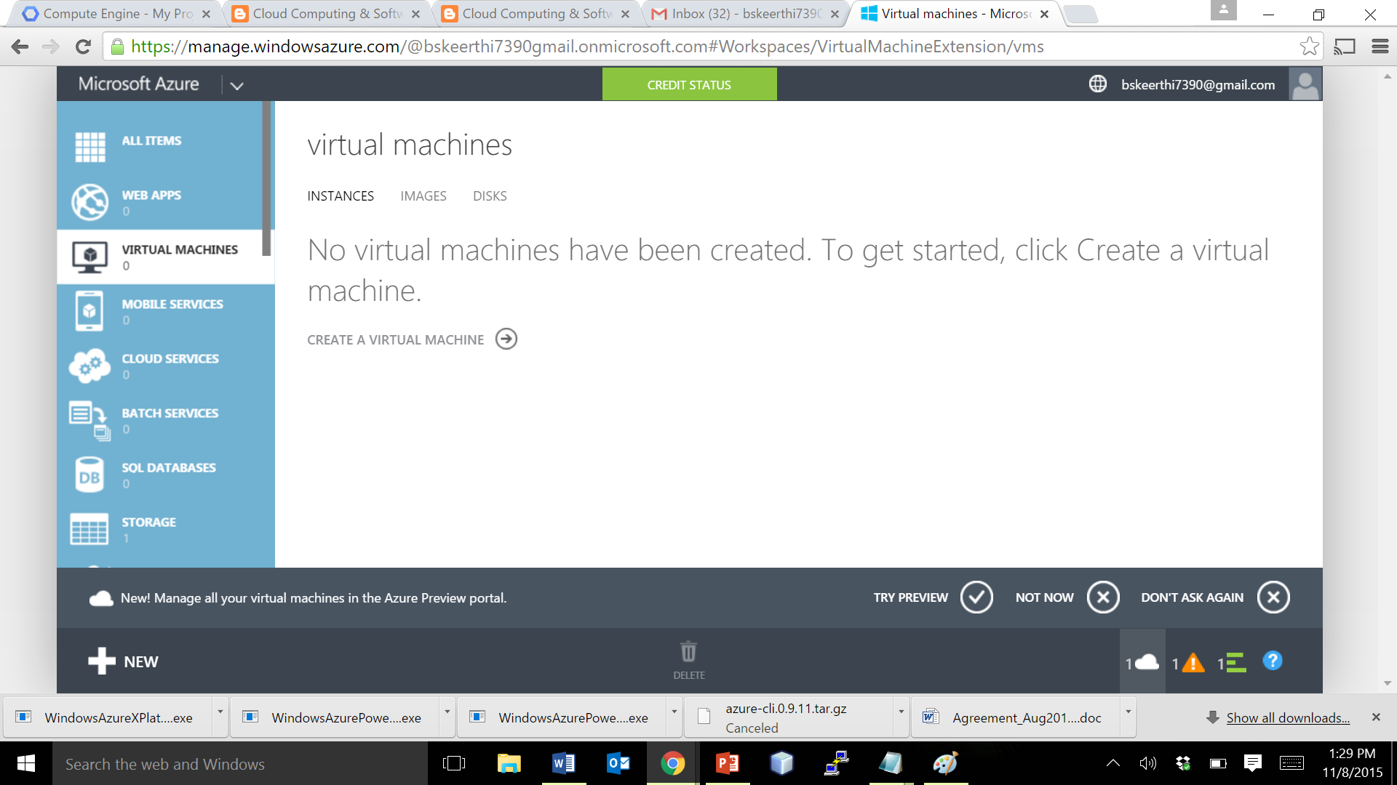
Creating an Instance using the Console
The Left Pane contains the link to all the services under Azure IaaS
Click on Create a Virtual Machine button to start a VM

Slide 35
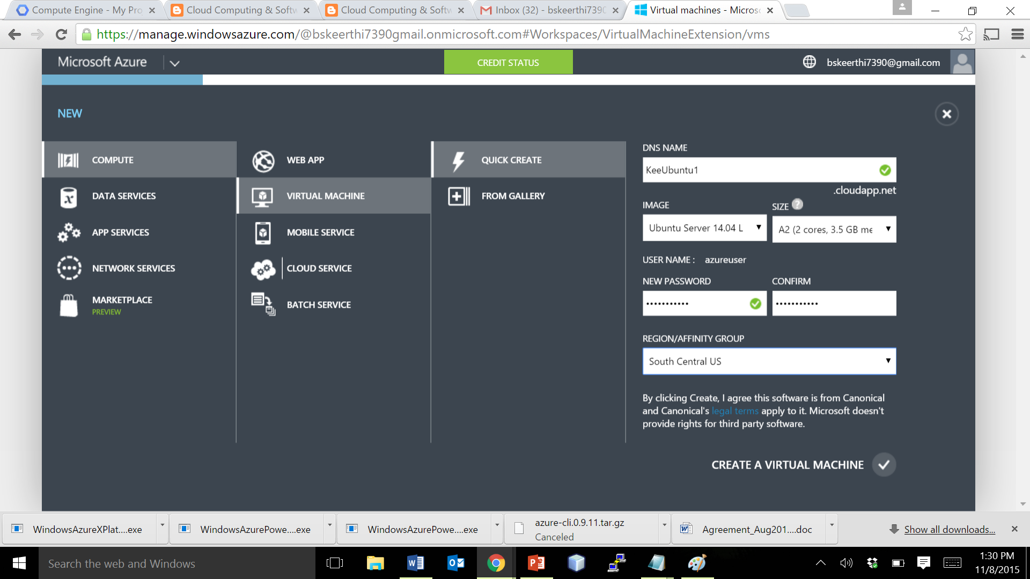
Creating an Instance – Ways to do it
There are two ways to create instances – Quick Create, and From Gallery.
Now, Enter the VM details , click on Quick Create.

Slide 36
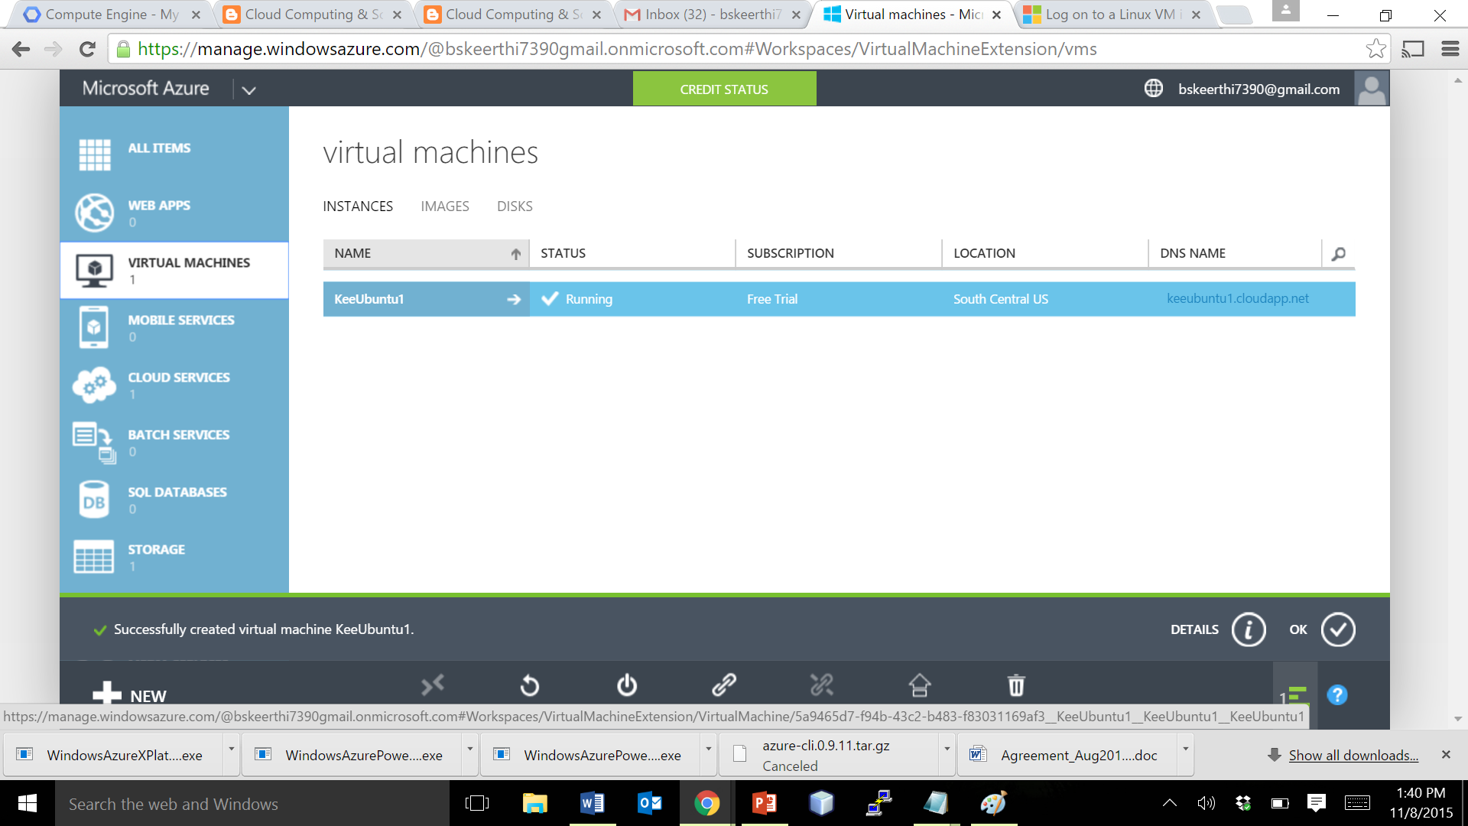
Creating an Instance – VM Created
You’re done. The VM is created, and it appears in the console.

Slide 37
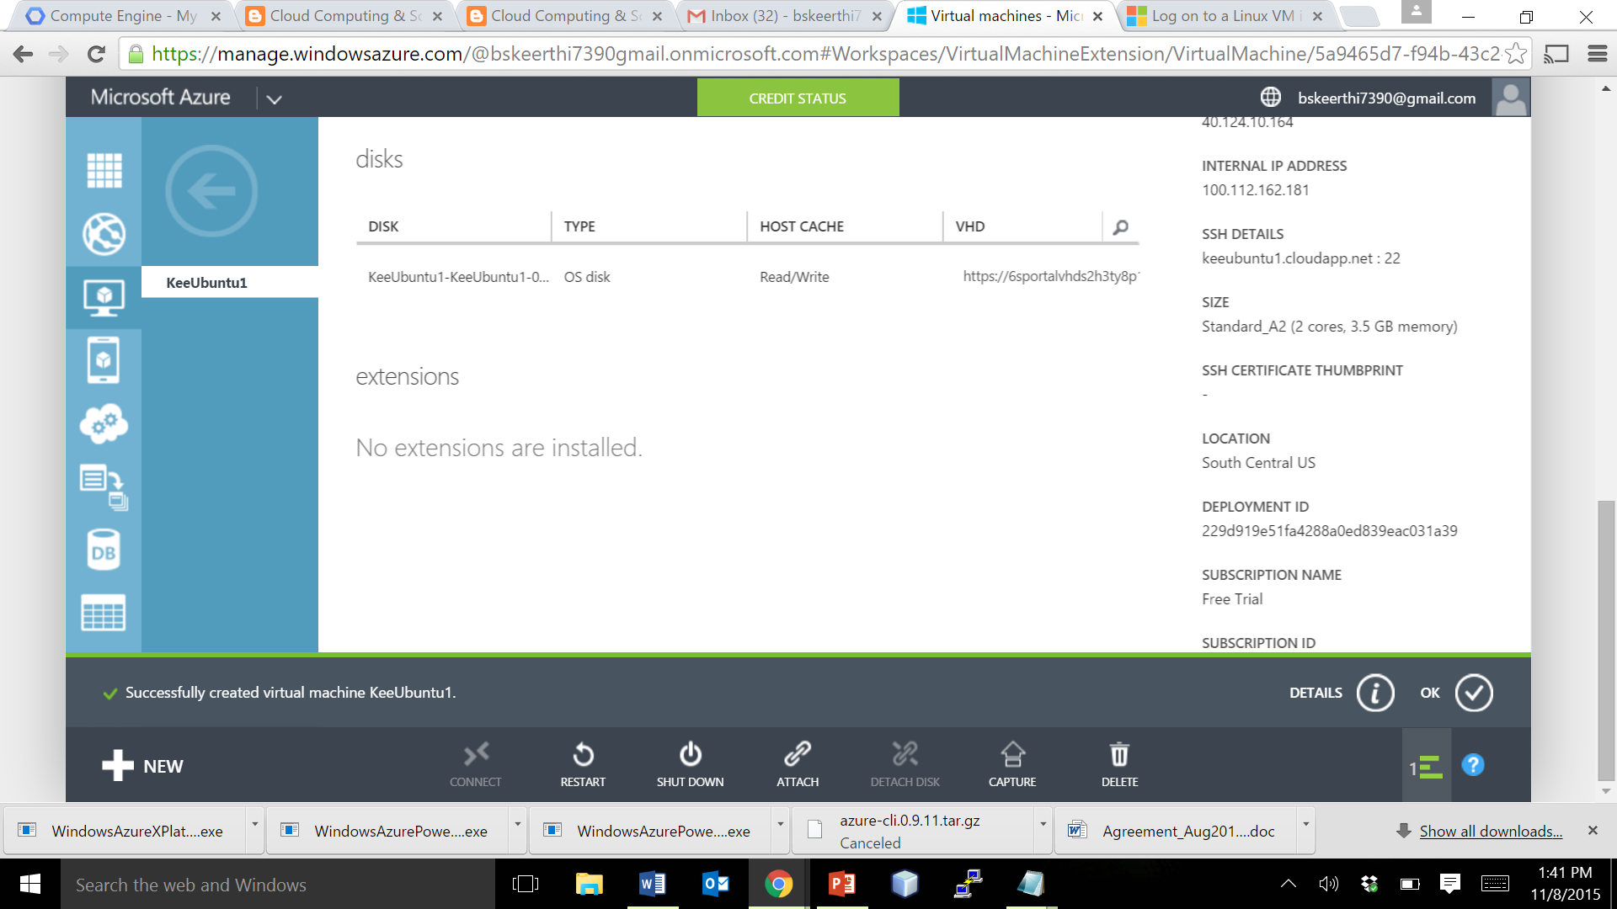
Creating an Instance – VM Details
Clicking on a VM, provides you the details about it

Slide 38
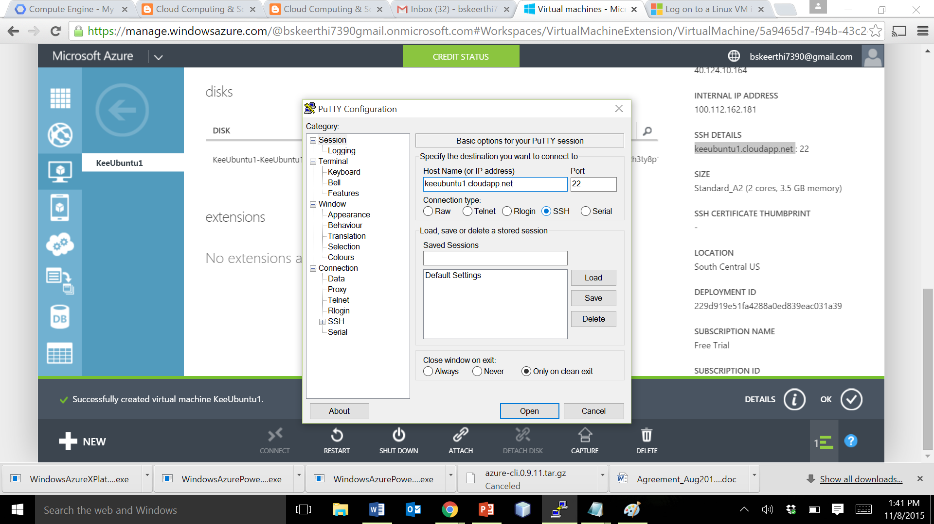
Connecting to an instance – SSH puTTY
Note the SSH Details here in the console, and copy it.
Open puTTY, paste the URL, port number here and Click Open.

Slide 39
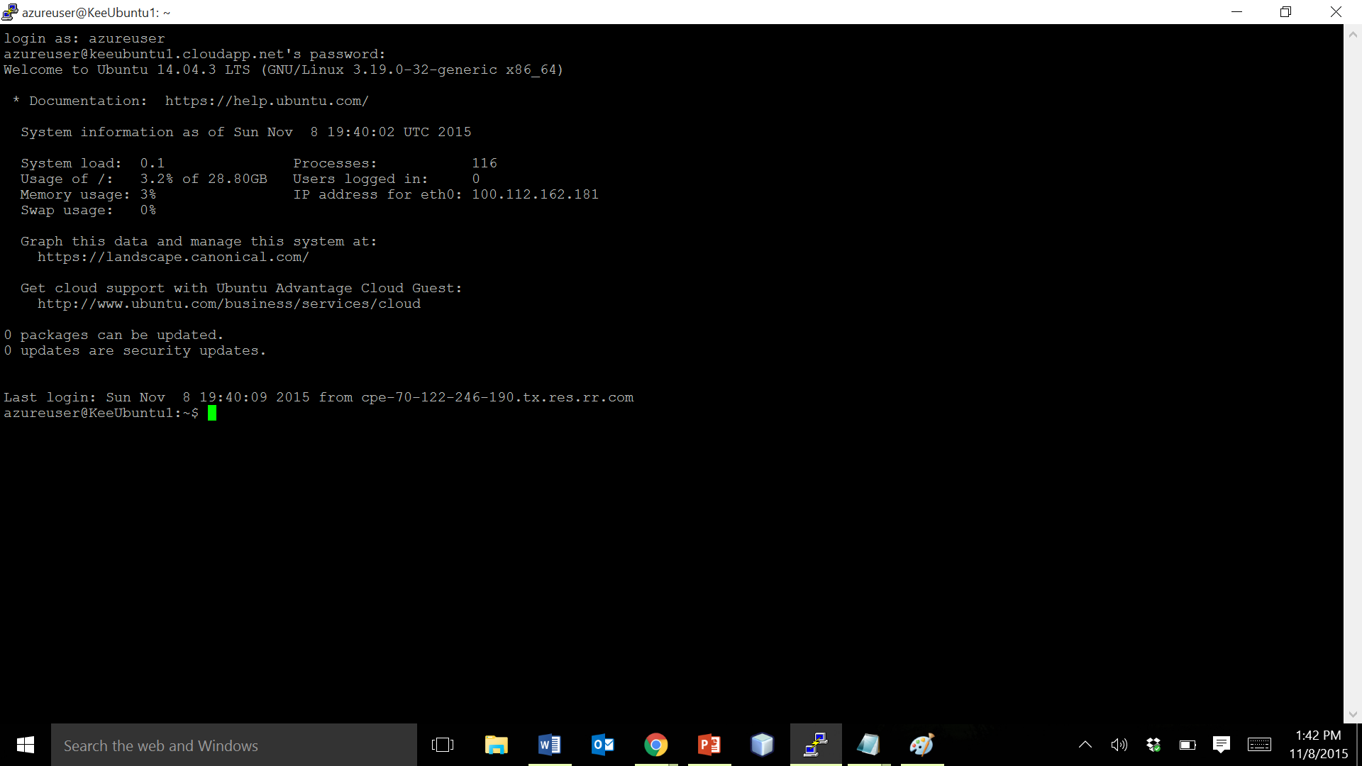
VM Launched
The VM is now connected.

Slide 40
Some issues you want to know?
Issue 1: 3 nodes were created. But these nodes were independent & were unable to be clustered.
Possible Reason & Solution : When we use Quick Create while creating VM, the default behavior sets each VM in a difference Cloud service hiding each VM from other VMs. Hence while creating a VM, the instances are picked from the gallery and all the VMs have to be made to be under same cloud service. The following snapshots illustrate this.

Slide 41
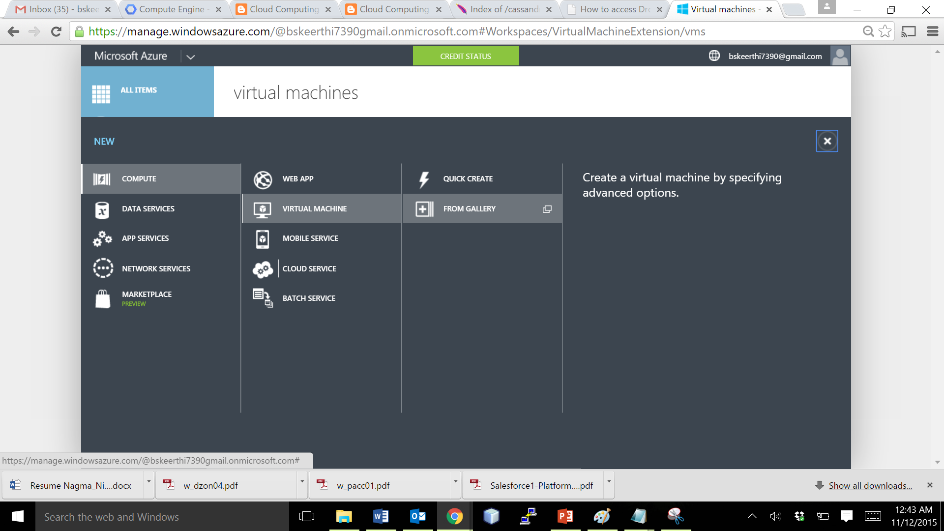
Issue 1 : Solution (Page 1/3)
While creating the VM, please choose FROM GALLERY

Slide 42
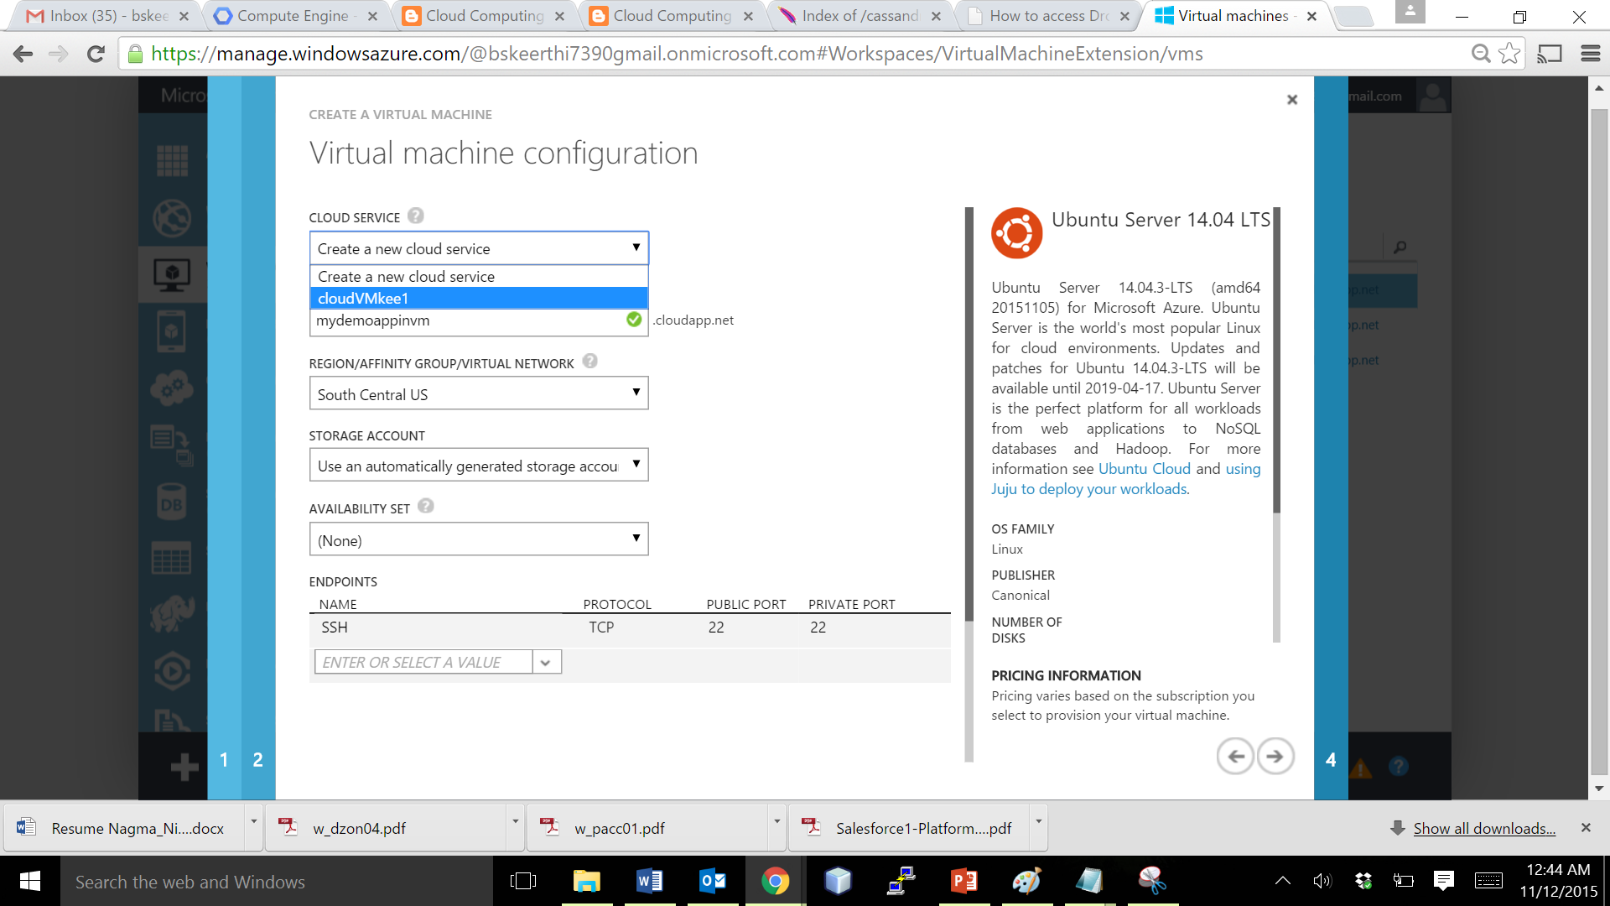
Issue 1 : Solution (Page 2/3)
Select your desired OS, and click the Cloud Service similar to that of the other VMs you want to cluster

Slide 43
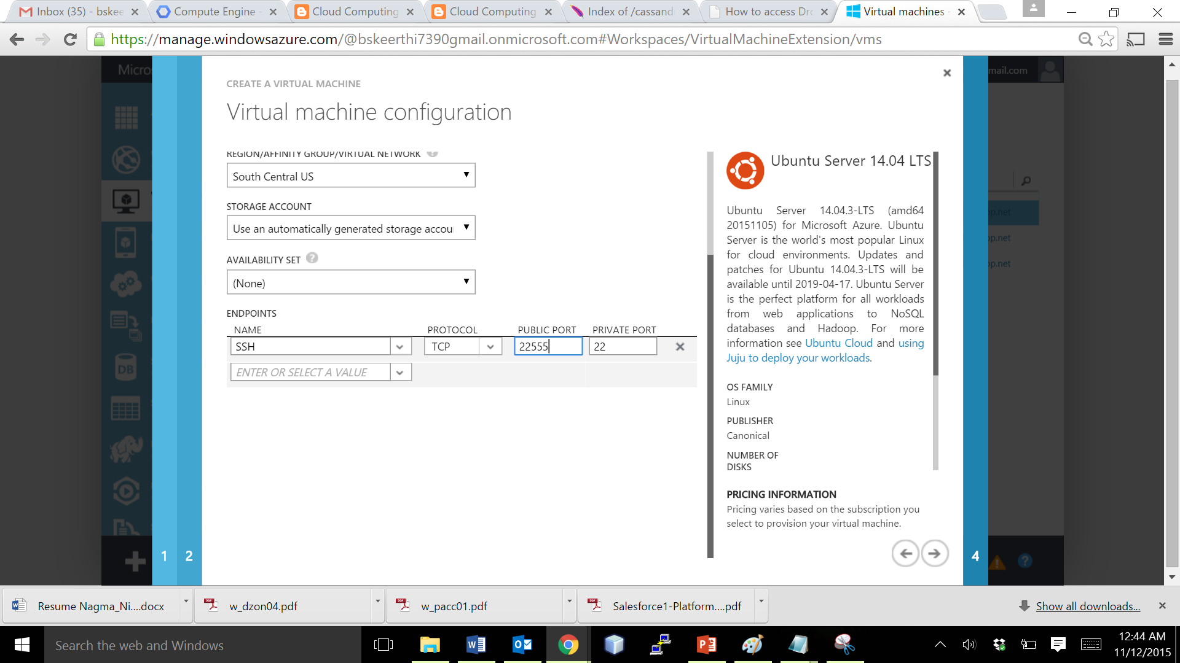
Issue 1 : Solution (Page 2/3)
Note that, each VM under same cloud service must have different public ports for connecting them via SSH. Hence, change the public port to a value within the TCP range.
VM will be created under same Cloud Service, and can be clustered easily

Slide 44
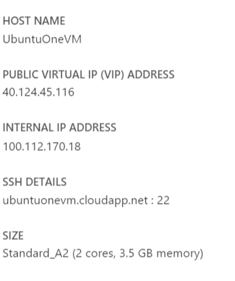
Configuration of an Azure instance

Slide 45
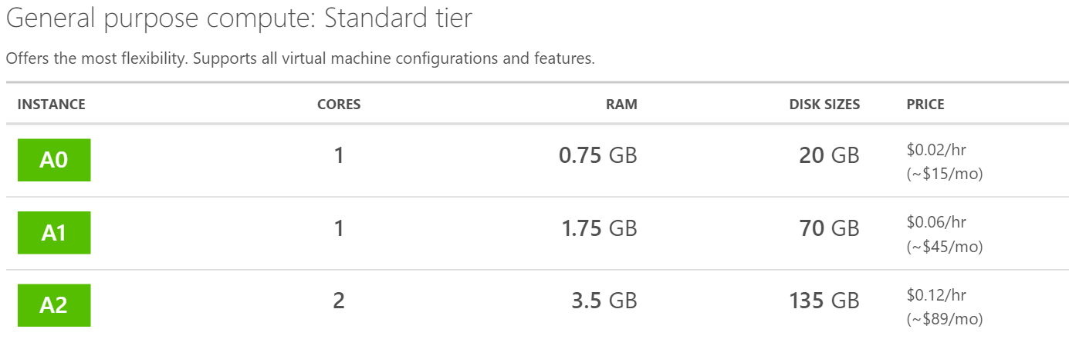
Pricing of an Azure instance

Slide 46
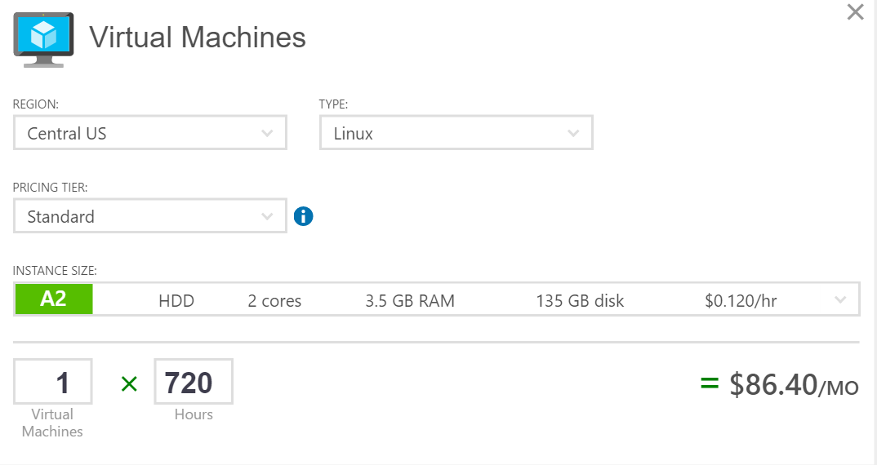
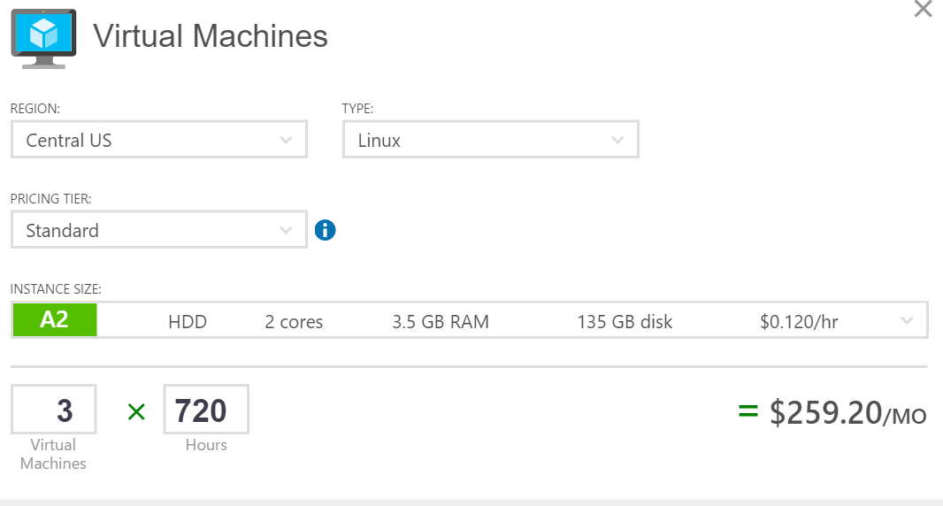
Monthly Estimate for 1 and 3 VMs

Slide 47
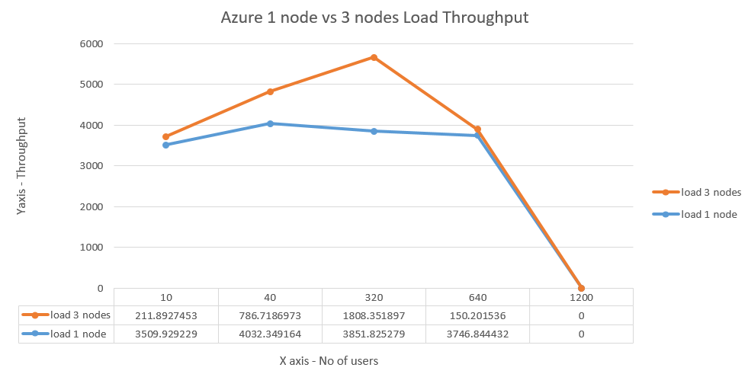
Graph Analysis of Azure Load Throughput

Slide 48
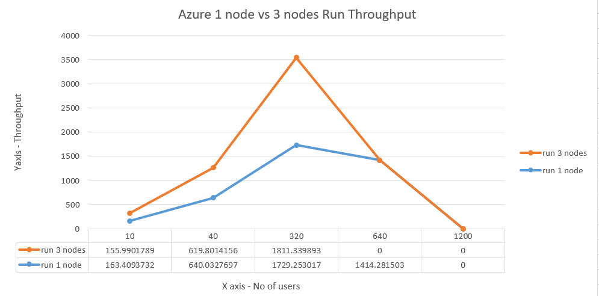
Graph Analysis of Azure Run Throughput

Slide 49
Public Cloud Services – Under Study

Slide 50
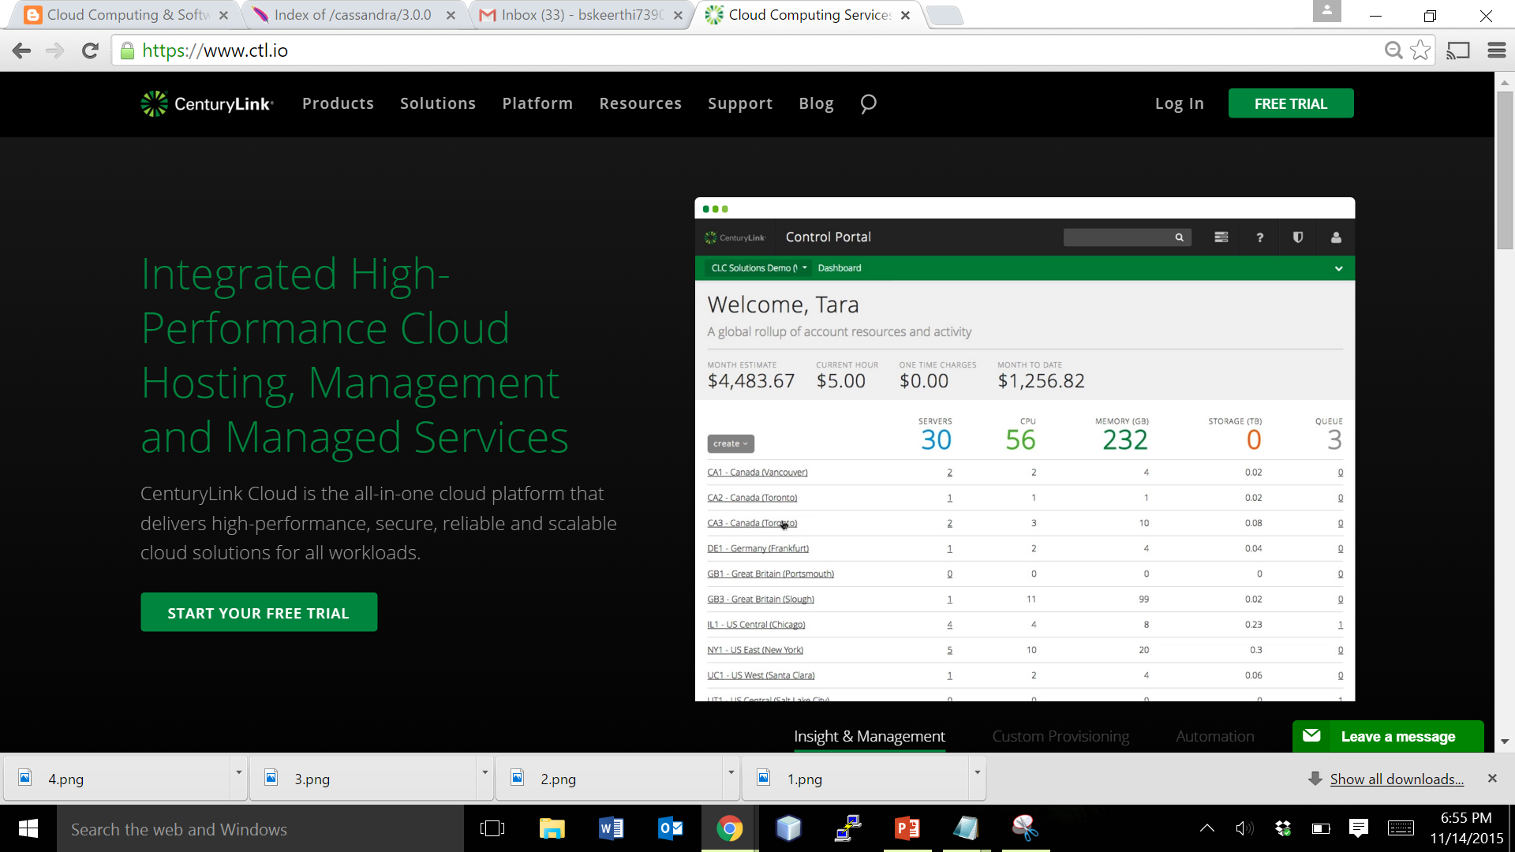
Creating an User ID for CenturyLink
Navigate to the URL https://www.ctl.io/ → Create an ID, or use your existing gmail ID to sign up. Initially every user gets $2500 free credit that can be used upto 30 days from the date of sign up.
1. Click on Free Trial

Slide 51
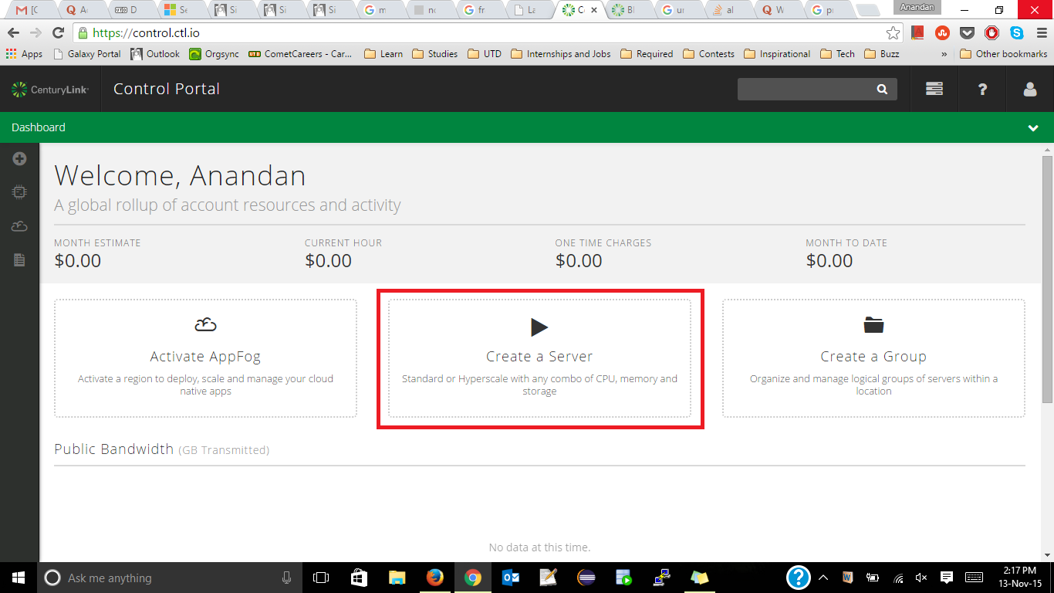
Logging in to Console
Click on Create a Server

Slide 52
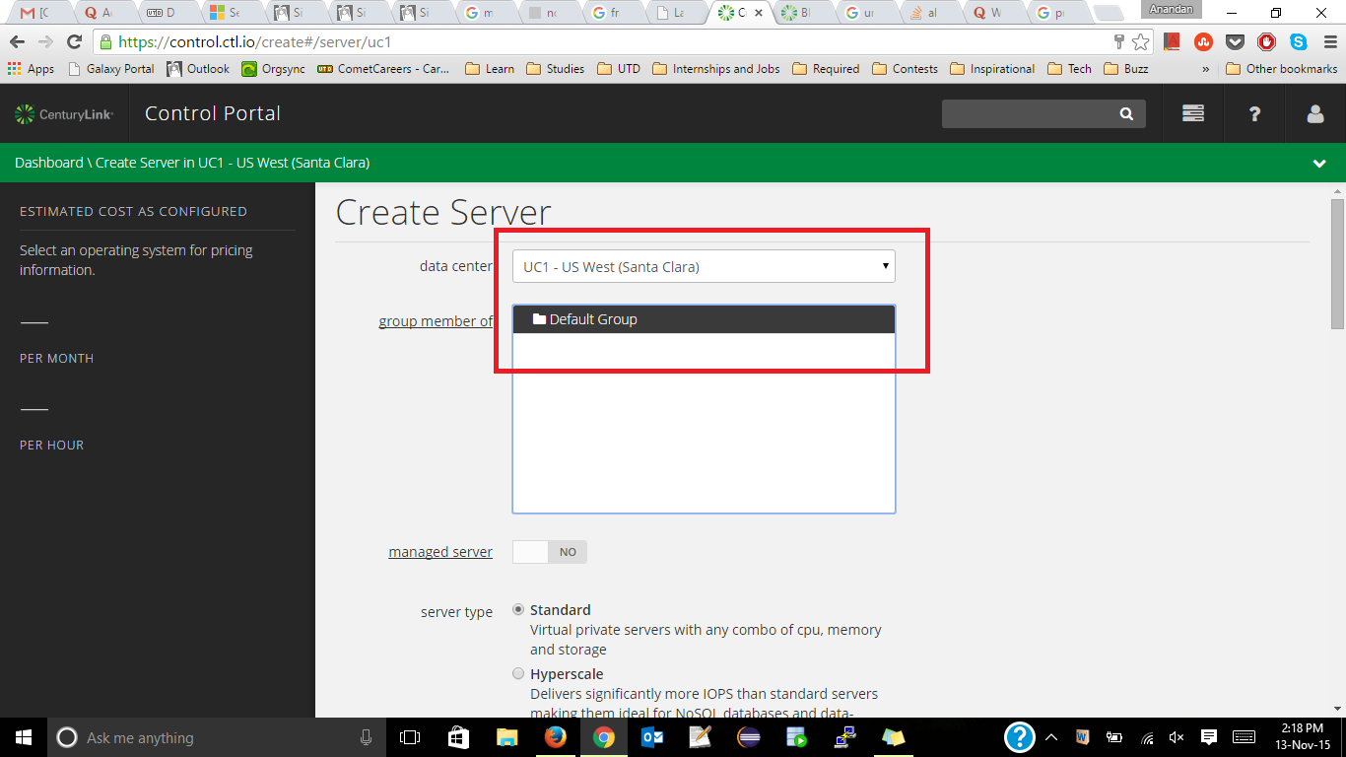
Creating an Instance – Step 1/4
The Control Portal gives you complete control to manage your VMs
Select the data center you wish for your VM based on Geography

Slide 53
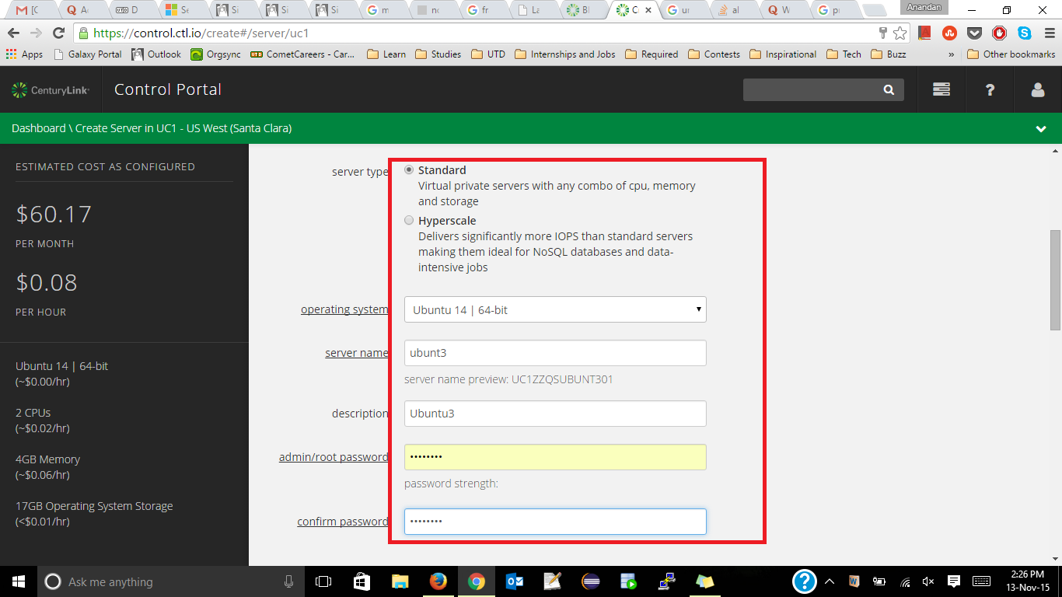
Creating an Instance – Step 2/4
Google Compute Engine helps you to launch instances within a minute. So Simple ☺
2. Estimated cost is shown here
Select the VM parameters in this screen.

Slide 54
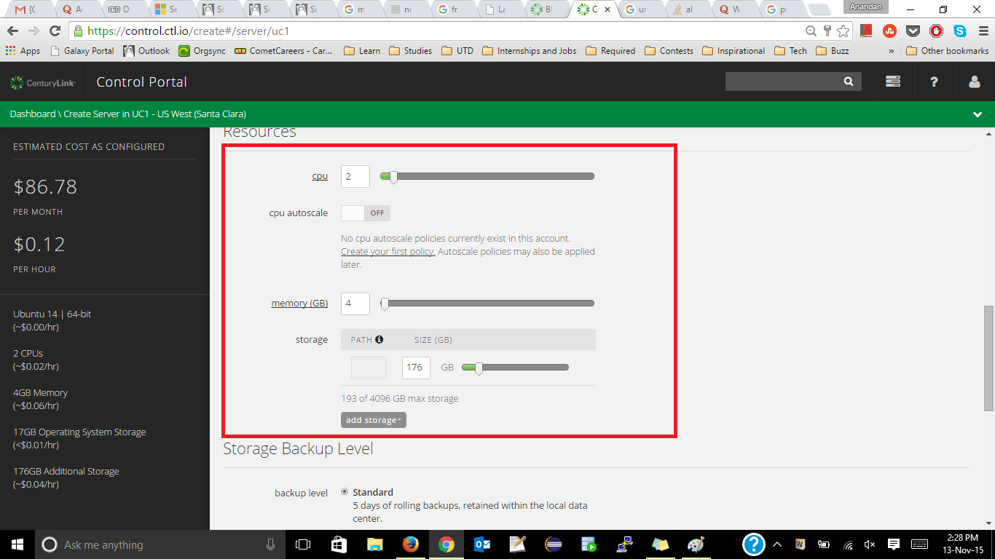
Creating an Instance – Step 3/4
Choose the storage, computing, and memory parameters in this screen.

Slide 55
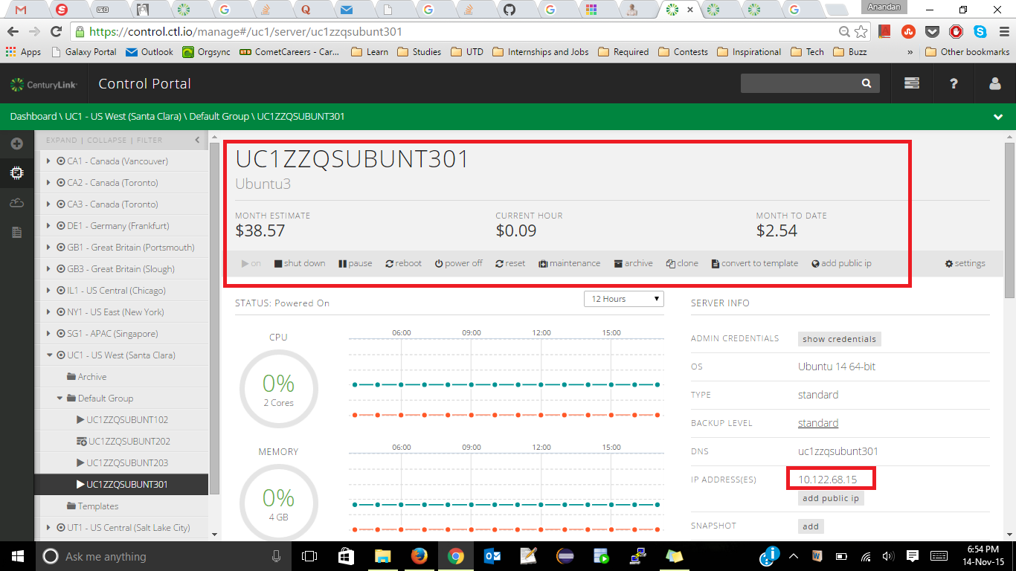
Creating an Instance – Step 4/4
1. VM is created. Note that a random name is allotted to the VM.
2. Note the IP address of your VM

Slide 56
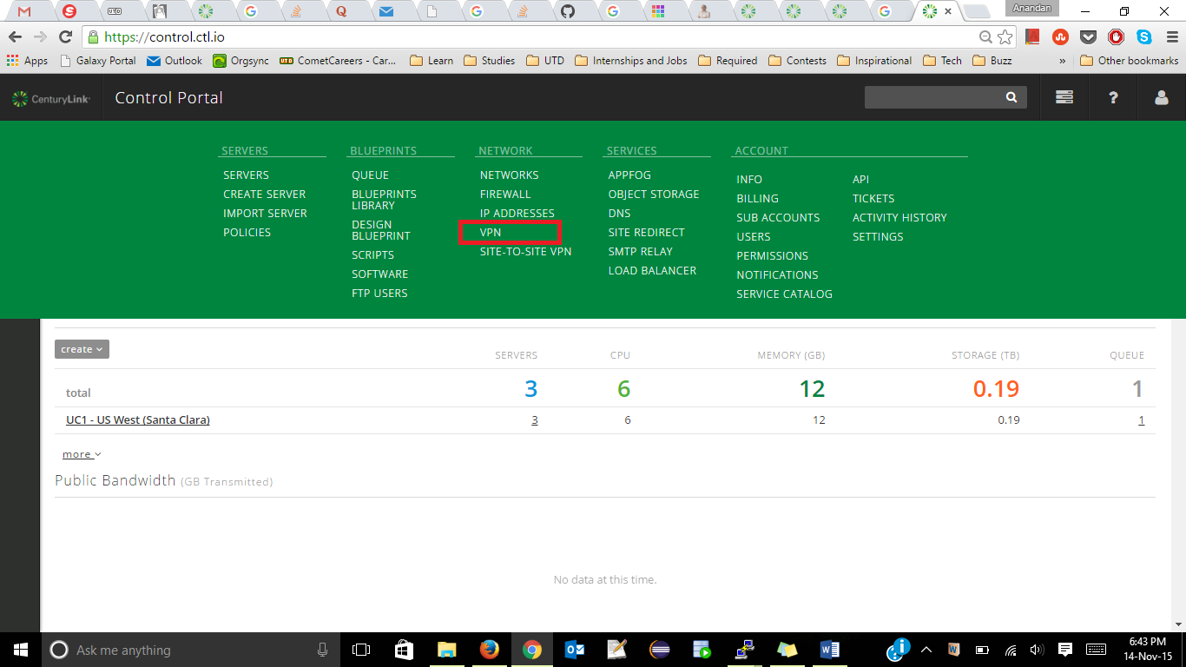
Connecting the Instance – Step 1/5
Under Control Portal → Network → Click VPN

Slide 57
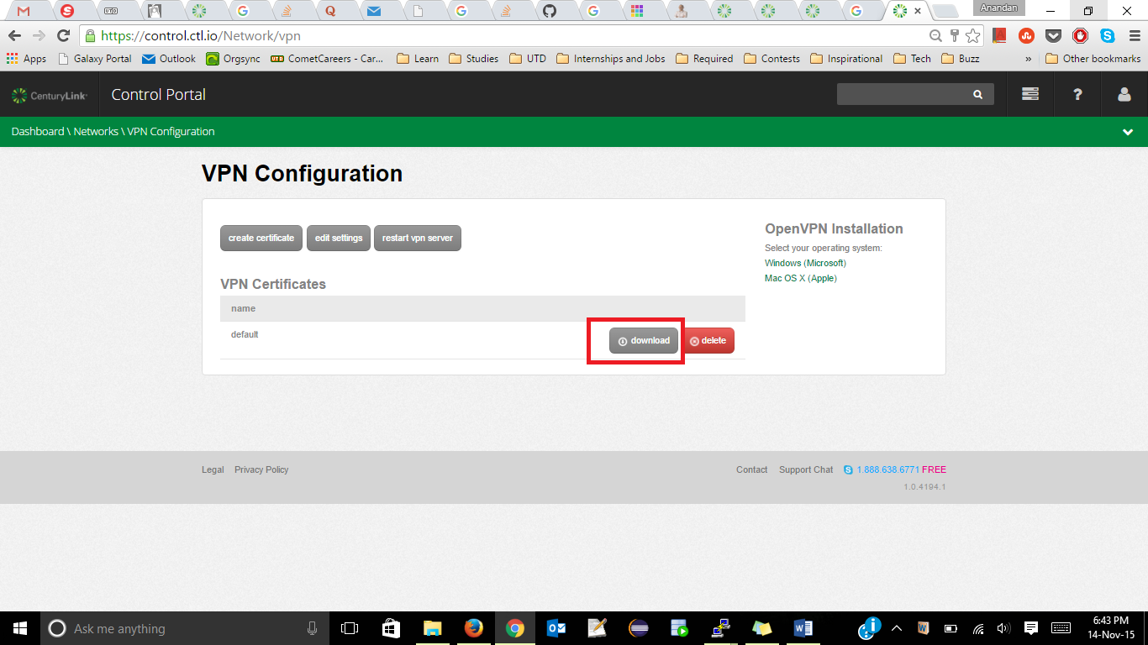
Connecting the Instance – Step 2/5
Click on the download button under the VPN Configuration & install the Application that is downloaded.

Slide 58
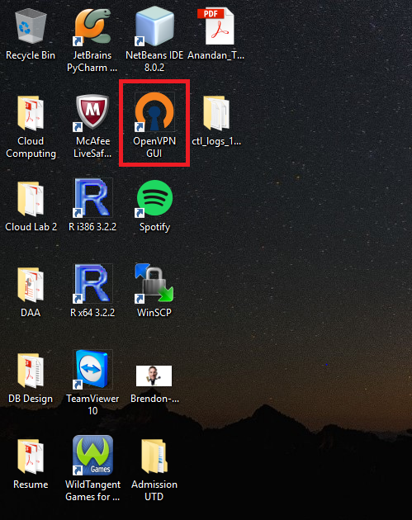
Connecting the Instance – Step 3/5
Click on OpenVPN GUI Application

Slide 59
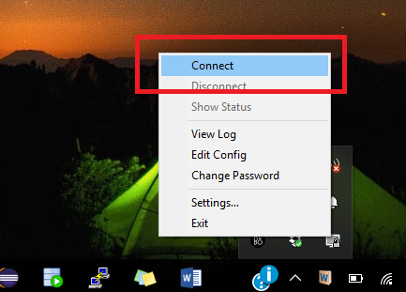
Connecting the Instance – Step 4/5
Check the system tray and click on the VPN icon, to get a pop up menu as shown. Click on Connect to get connected VM.

Slide 60
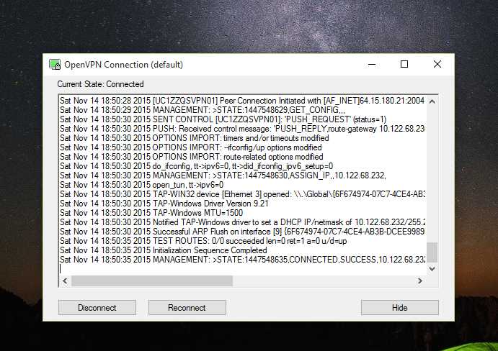
Connecting the Instance – Step 5/5
You will get a notification window where you can Reconnect or Disconnect the VM.

Slide 61
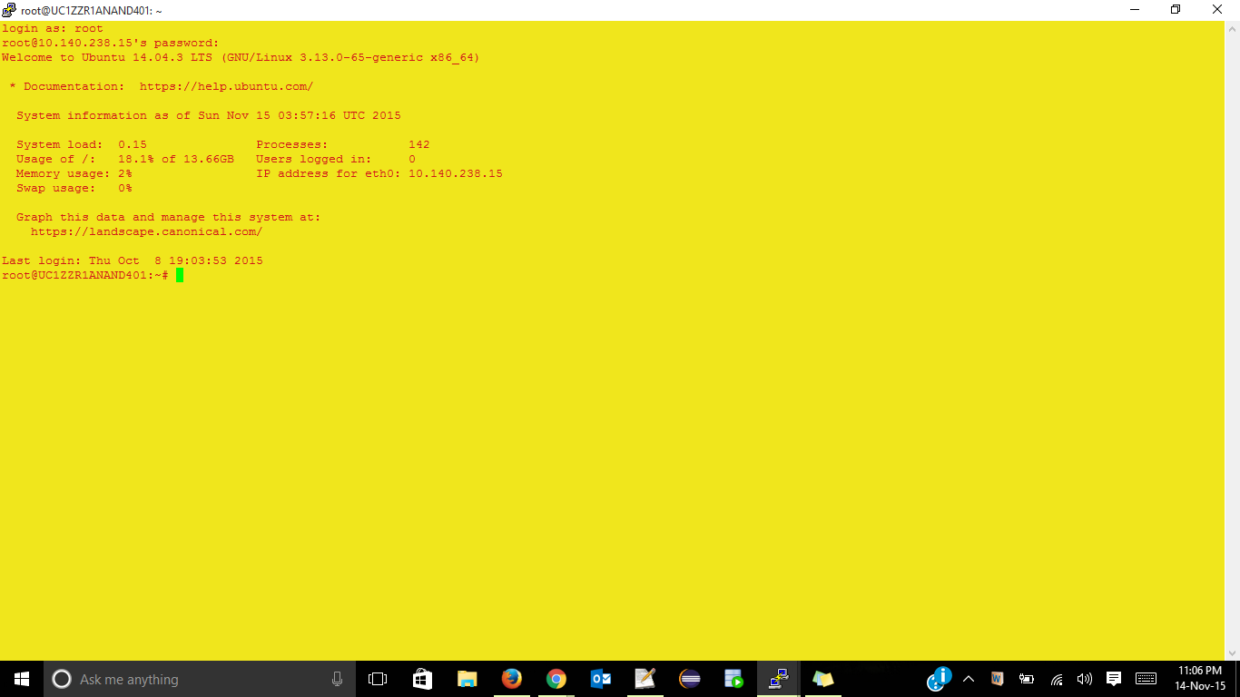
Instance Launched
Instance is launched automatically

Slide 62
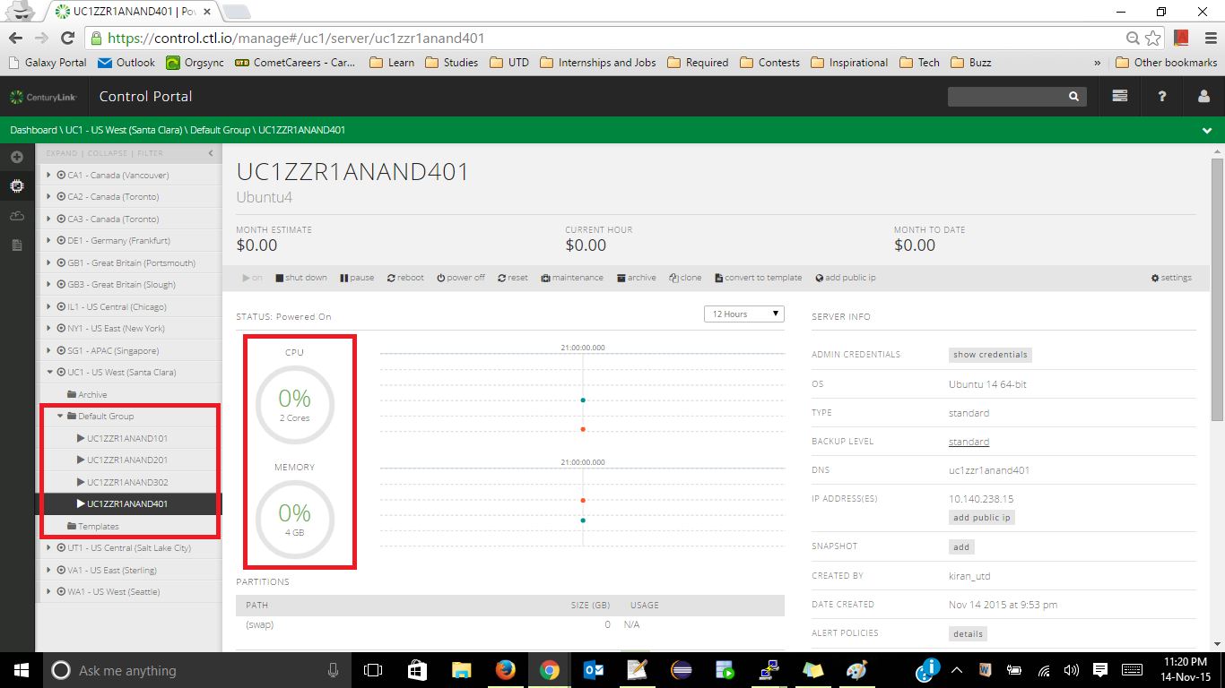
Benchmarking : 3 Nodes + 1 Test Node
Create 3 VMs for Cassandra Cluster Setup, and 1 for Test Node

Slide 63
Configuration of a CenturyLink instance

Slide 64

Pricing & Estimate of CenturyLink

Slide 65

Graph Analysis of CTL Load Throughput

Slide 66

Graph Analysis of CTL Run Throughput

Slide 67
Public Cloud Services – Under Study

Slide 68

Creating an Instance – Login to AWS
Navigate to the URL aws.amazon.com → Create an Amazon ID, and get in to the login page of the console as shown in the below figure.
1. Select your region. Instances available depends on the value that you select here.
2. Click on EC2 – to create VM instances.

Slide 69

Creating an Instance – EC2 Dashboard
This is the EC2 Dashboard, where in the instances, and its associated components such as Events, Volumes, Network, Security, and other parameters can be modified.
1. You can view the list of resources that is currently being deployed/used in AWS EC2.
2. Click on Launch Instance

Slide 70

Creating an Instance – t2.medium
t2.micro is the lowest available Instance Type. This instance type is available free for 12 months.
Amazon offers $100 free credit to use free services
For benchmarking purpose, we create t2.medium which is a premium service offered by AWS

Slide 71

Creating an Instance – Instance Details
Configure the instance details

Slide 72

Creating an Instance – Storage Details
Configure the storage details

Slide 73

Creating an Instance – Security Group
Configure the security group details

Slide 74

Creating an Instance – Boot
Configure the Boot option

Slide 75

Creating an Instance – Downloading Key
Create a new key pair, and Download this key, which will be used to connect the instances via puTTY.

Slide 76

Creating an Instance – Review & Launch
Save the key in your safe directory. If this key is lost, then the instance cannot be connected via puTTY

Slide 77

Creating an Instance – Review & Launch
Review and you are ready to go ☺

Slide 78

Instance – Billing preferences
You can also set your billing preferences to keep track of your usage & its expenses

Slide 79

AWS Console
You can see VMs in the dashboard

Slide 80

Connecting to an instance
We have 2 options to connect. We will see how to connect an instance via puTTY

Slide 81

Connecting via puTTY
Open PuTTYgen, Conversion→ Import Key

Slide 82

Connecting via puTTY
Select the key that was downloaded when creating the instance

Slide 83

Connecting via puTTY
Create a Private key as shown in snapshot

Slide 84

Connecting via puTTY
Save the private key

Slide 85

Connecting via puTTY
Open puTTY, Navigate to Connection→ SSH → Auth, and select the Private Key that you have saved.

Slide 86

Launching the instance
Copy the Public IP from AWS Console
Click Session, and paste the IP and click on Open

Slide 87

VM connected
VM instance is connected.

Slide 88

Creating other instances
Create and launch Other VMs in the same manner.

Slide 89

Benchmarking–3 Nodes and 1 Test Node
Create 3 Nodes and 1 Test Node for benchmarking

Slide 90

Some issues you might want to know?
Issue 1: While running Cassandra in the node, error was : IP is in use by another process. Error screenshot is pasted below.
Possible Reason & Solution : In the Cassandra.yaml file, the storage port can be changed to another value, and Cassandra to be restarted.
Sometimes when Cassandra process is killed, and restarted, this problem gets resolved.

Slide 91

Some issues you might want to know?
Issue 2: A Java memory exception occurred when Cassandra was started. The exception snip is shown below.
Possible Reason & Solution : This issue occurs when t2.micro instance is chosen. The configuration was not enough to run JVM. One way to resolve is to change the instance to t2.medium which was sufficient enough to run JVM. Another way to resolve in t2. micro itself is to change the JVM heap size from the default to user specified using the below command :
export _JAVA_OPTIONS="-XX:ParallelGCThreads=1 -Xms200m -Xmx300m"

Slide 92

Configuration of an AWS instance

Slide 93

Pricing of an instance

Slide 94

Monthly estimate

Slide 95

Graph Analysis of AWS Load Throughput

Slide 96

Graph Analysis of AWS Run Throughput

Slide 97

BENCHMARK DISCUSSION
The next section provides benchmark results obtained from the analysis of 4 CSPs subjected to study…

Slide 98
Comparison of Running Time – 1 Node
The number of concurrent users | Amazon Web Services | Google Compute Engine | Microsoft Azure | CenturyLink IaaS
10 | 0 min 18.43 secs | 17.6 secs | 10.19 mins | 12.71 secs
40 | 1 min 1.48 secs | 43.68 secs | 10.41 mins | 33.93 secs
320 | 28.42 mins | 8.13 mins | 30.84 mins | 10.75 mins
640 | 0 | 0 | 75.42 mins | 30.56 mins
1200 | 0 | 0 | 0 | 0
*The best one in that category is highlighted in Red Font.
For 1200 users, higher configuration is recommended.

Slide 99
Comparison of Running Time – 3 Nodes
The number of concurrent users | Amazon Web Services | Google Compute Engine | Microsoft Azure | CenturyLink IaaS
10 | 21.07 secs | 19.69 secs | 10.68 mins | 15.406 secs
40 | 1 min 1 sec | 1 min 9 secs | 10.75 mins | 36.628 secs
320 | 8.67 mins | 13.3 mins | 29.44 mins | 14.78 mins
640 | 0 | 38.29 mins | 0 | 27.70 mins
1200 | 0 | 0 | 0 | 72 mins
*The best one in that category is highlighted in Red Font
For 1200 users, higher configuration is recommended.

Slide 100
CSPs Using 1 Node – Load Throughput

Slide 101
CSPs Using 3 Nodes – Load Throughput

Slide 102
CSPs Using 1 Node – Run Throughput

Slide 103
CSPs Using 3 Nodes – Run Throughput

Slide 104

Performance per price in Azure

Slide 105
Performance per price in GCE

Slide 106
Performance per price in CenturyLink

Slide 107
Performance per price in AWS

Slide 108
Performance per price for 1 node – 4 CSPs

Slide 109
Performance per price for 3 node – 4 CSPs

Slide 110
Detailed Analysis
Benchmark Files will be provided on request. Please reach me @ keerthibalasundaram@gmail.com
I have uploaded the Graph analysis into my dropbox, feel free to comment on it: https://goo.gl/Ep0qjC

